Slide 1
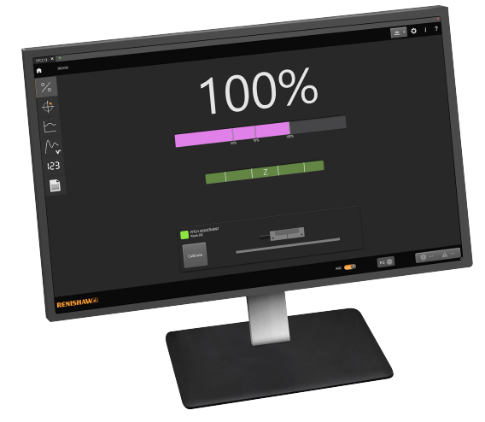
Advanced Diagnostic Tool ADTi-100
ADTi-100 in combination with ADT View software offers:
01
02
03
Suitable for challenging installation environments
Traceability – serial number,
configuration,
signal size
In-field diagnosis and fault finding
04
05
Data exportable as a .csv file
Use inline with a controller or connected to a computer

Slide 2
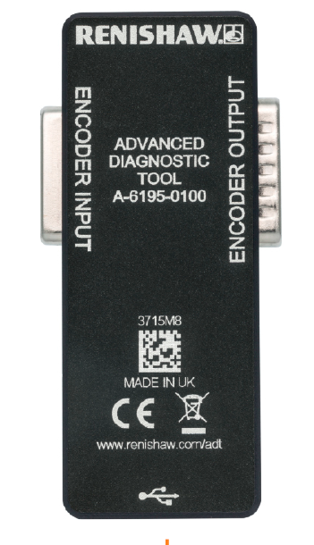
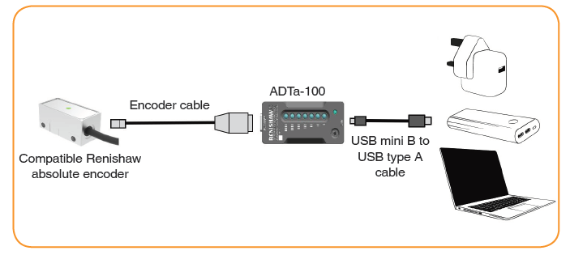
Advanced Diagnostic Tool ADTi-100
Operates connected to a PC running the ADT View software
ADTi-100
Optional connection to controller for inline operation
Encoder cable
Compatible Renishaw incremental encoder
USB mini B to USB type A cable
ADTi-100

Slide 3
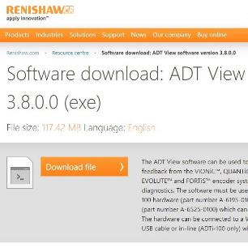
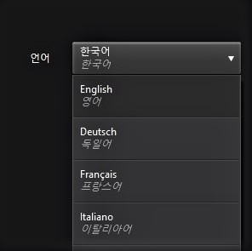
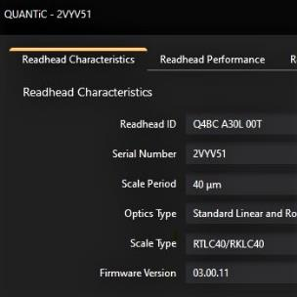
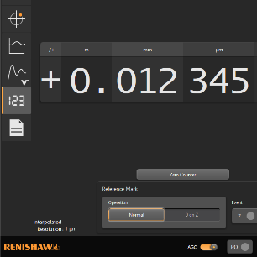
Advanced Diagnostic Tool ADTi-100
ADT View software
Free website download
Multiple language options
Auto selects readhead
Digital position readout

