Slide 1
NC-PerfectPart
The pursuit of perfection

Slide 2
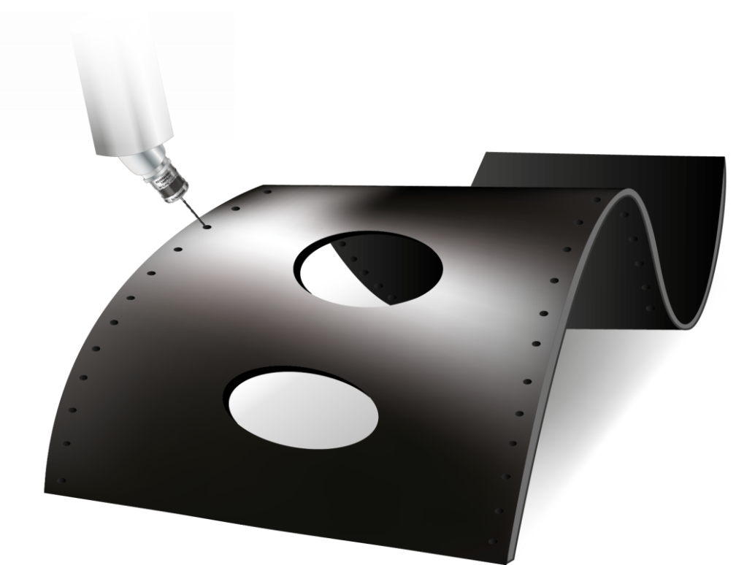
NC-PerfectPart - Overview
“Our mission is to enable our customers to make perfect parts without specialist knowledge.”
“A perfect part is made within tolerance, with zero concessions and guaranteed quality, day after day, part after part.”

Slide 3
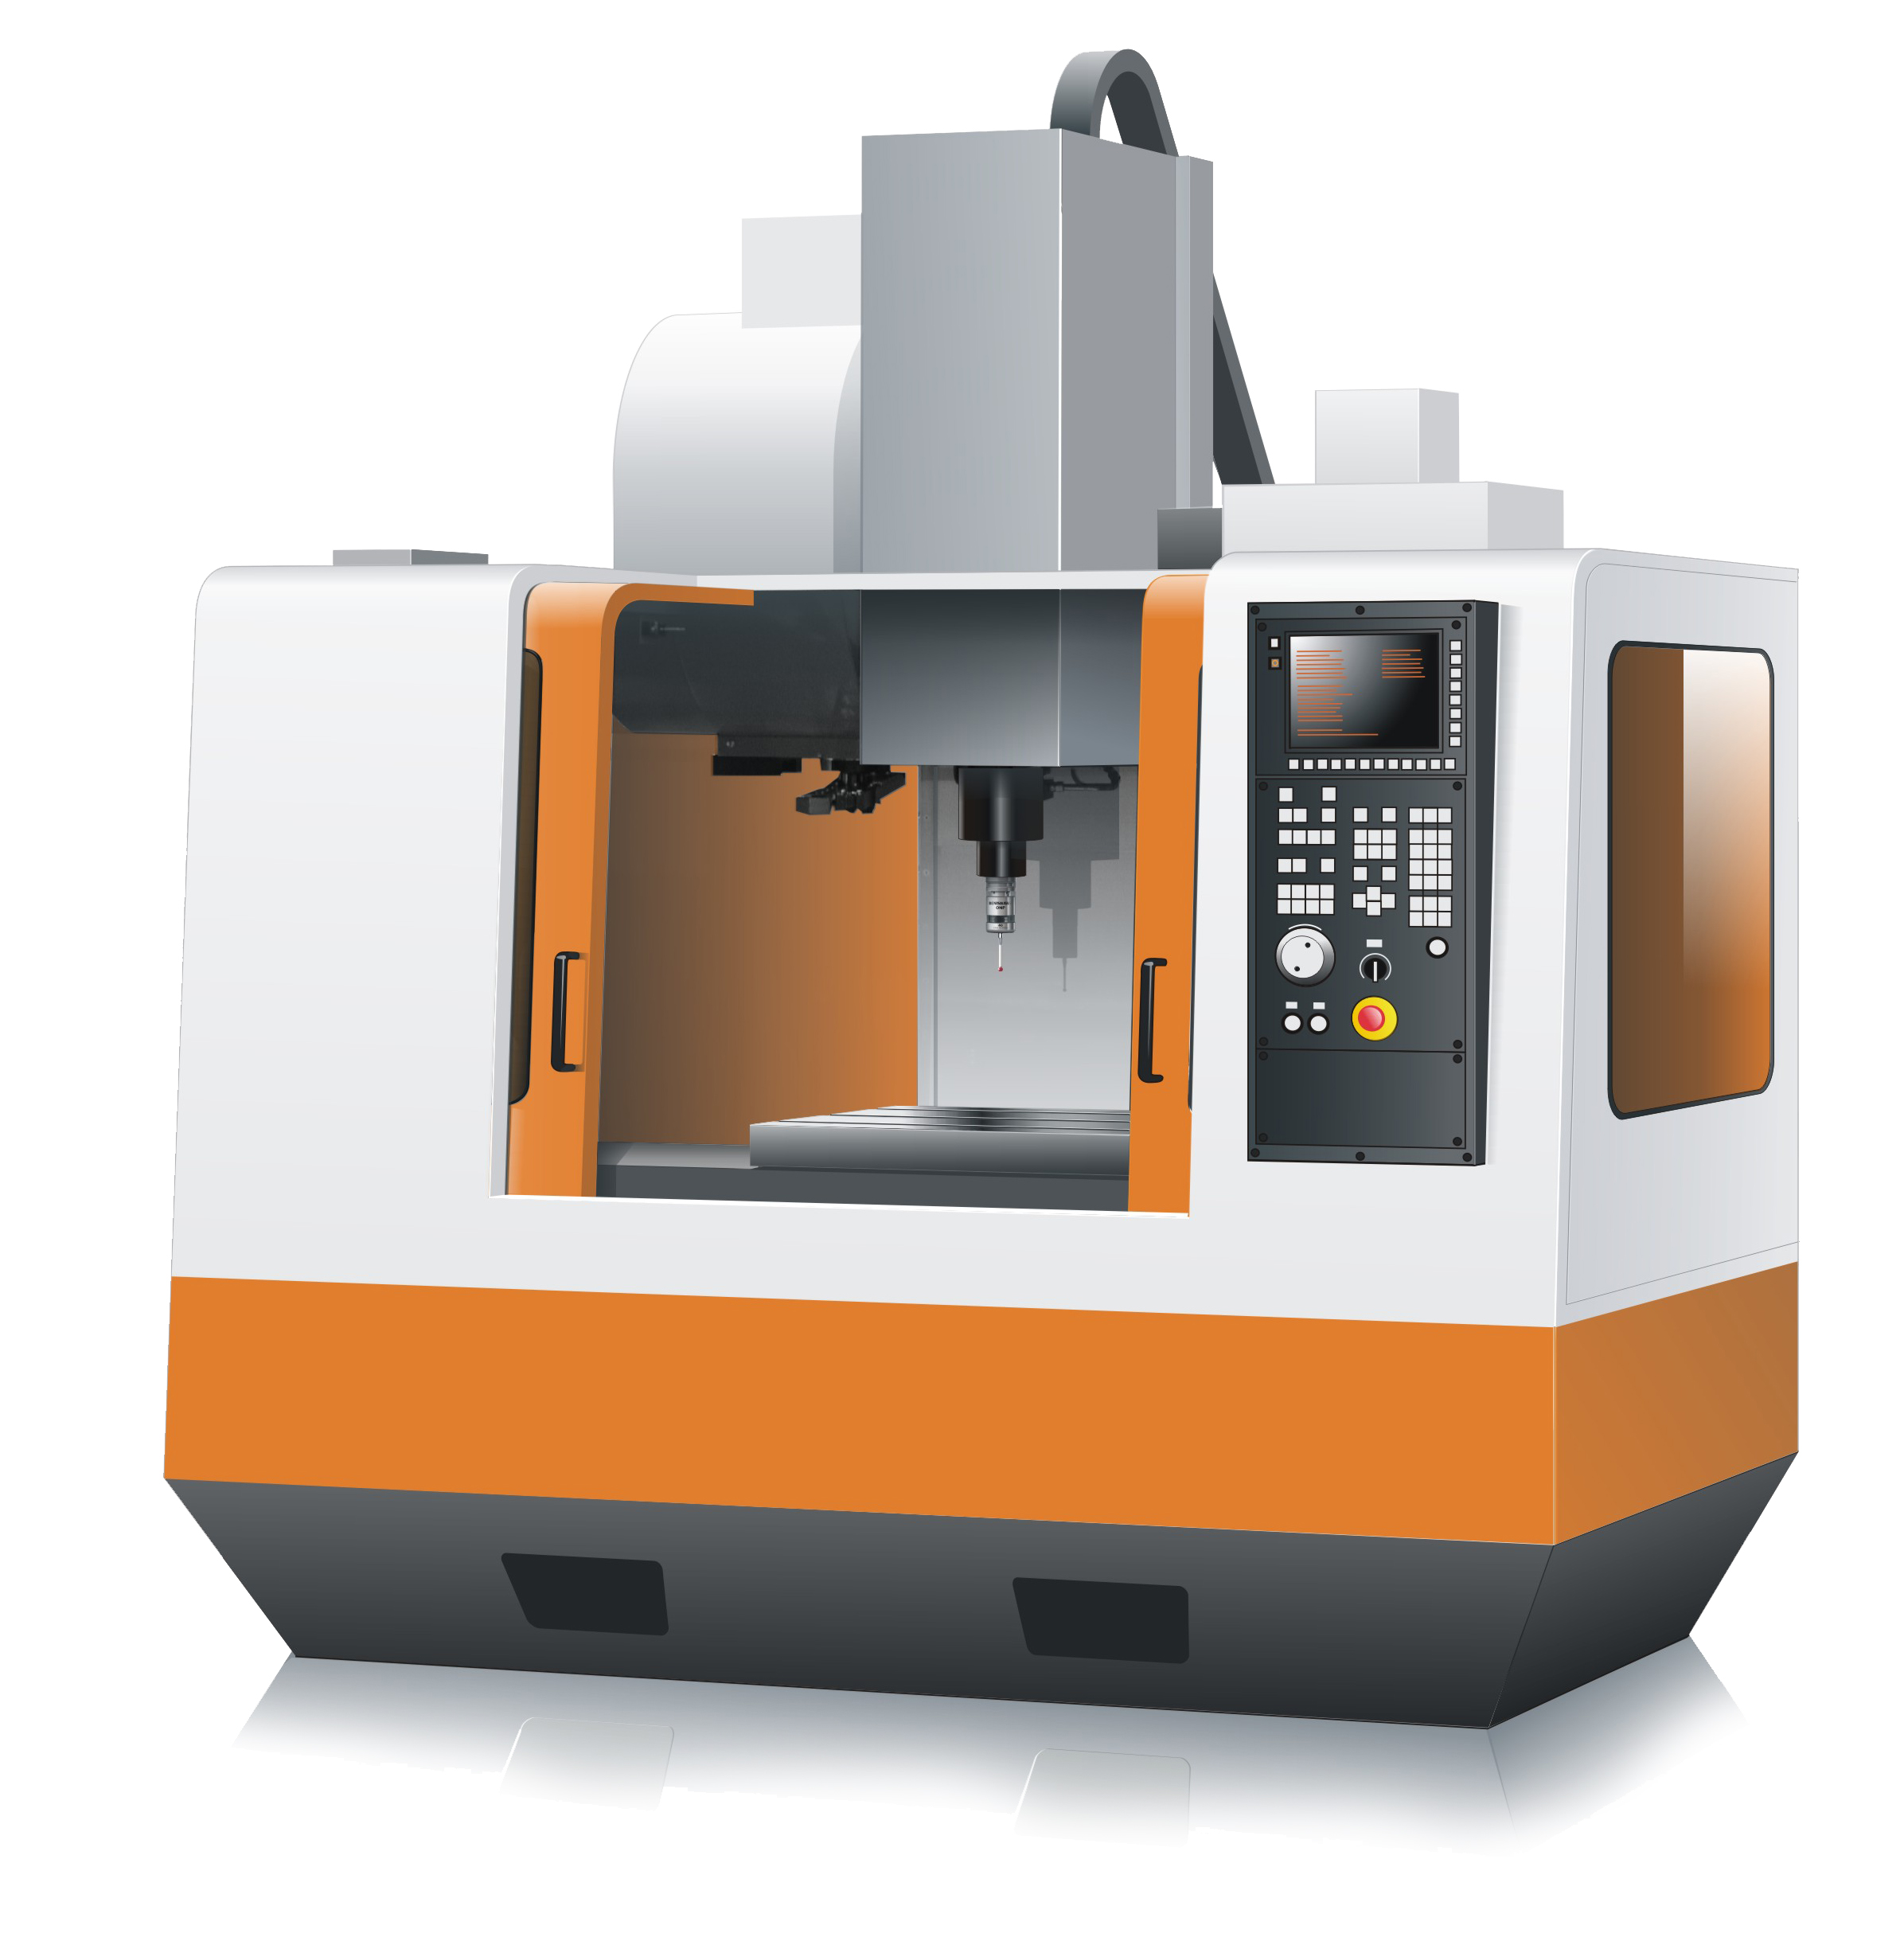
NC-PerfectPart - Overview
NC-Checker
NC-PartLocator

Slide 4
The route to perfection – A capable machine tool
?
Is your machine tool capable of producing your parts?
Has it a probing system accurate enough to measure for part quality required?
Is probing system calibrated in 5-axes to maximise measurement accuracy?
Is probe performance accurate enough to satisfy part quality requirements?
Does 5-axis geometric performance of whole machine satisfy part quality requirements?
Is the machine capable of maintaining this performance all day, and day after day?
?
?
?

Slide 5
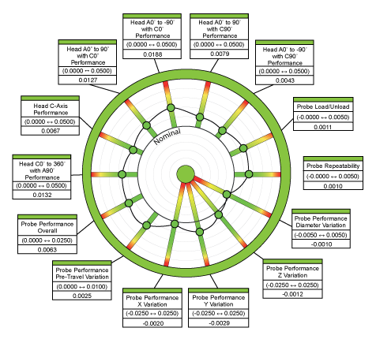
The route to perfection – NC-Checker
Our benchmark system lets you:-
Prove machine tool capability
Anticipate maintenance
Discover machine geometry errors
On error stop process to enforce part quality

Slide 6
The route to perfection – NC-Checker benefits
Instant visual assessment
Benchmark wheel gives you an
easy to understand visual report
Higher part quality
Reduced machine geometry errors
means reduced part errors
Simple Go/No-Go operation
Designed for operators, trained
in a day, makes it easy to run
Uniform part quality
Converging geometric performance
means converging part accuracy
Predictive maintenance
See the trend, plan for maintenance,
avoid costly emergency call-outs
Day to day machine capability
Daily benchmark allows geometric
performance monitoring before cutting
Fully traceable archive
The history of every check, all the
data detail and the benchmarks
Machine to machine capability
Do your machines perform identically?
Find out why not and where

Slide 7
The route to perfection – Remove part setup errors
Is your part setup stopping you make good parts?
Is it manual and introducing too many random errors?
Is your fixturing accurate enough for the job?
Does your part setup procedure take too long?
If you have distortion in the part is it even possible to do a single manual alignment?
Zero location fixtures? Are you sure?
?
?
?
?

Slide 8
The route to perfection – NC-PartLocator
Automated part setup system:-
Schedules tighter and in control as part is setup in the same time, every time
Fully automatic system removes manual errors as not dependent on operator skill
Automatic compensation for all accumulated tolerance error build up in fixture assembly
Maximum accuracy automated procedure removes need for in-process measurement

Slide 9
The route to perfection – NC-PartLocator benefits
Condition of supply check
Pre-machining check shows the
quality of part delivered to machine
Higher part quality
Reduced part setup errors
means reduced part errors
Simple Go/No-Go operation
Designed for operators, trained
in a day, makes it easy to run
Uniform part quality
Automated setup means part
consistency guaranteed
Process integration
Integrated with existing process
to ensure smooth introduction
Discover errors before machining
Before machining you will be confident
the part is going to be perfect
Fully traceable archive
History of every measurement and
alignment stored against part numbers
Automatic operation
Human error eliminated and setup is
performed in a fixed time every time

Slide 10
Contacts
metrology software products ltd
6f, greensfield court, alnwick,
northumberland, ne66 2de
t: +44 (0) 1665 608193
e: info@metsoftpro.com
w: www.metsoftpro.com

