Slide 1
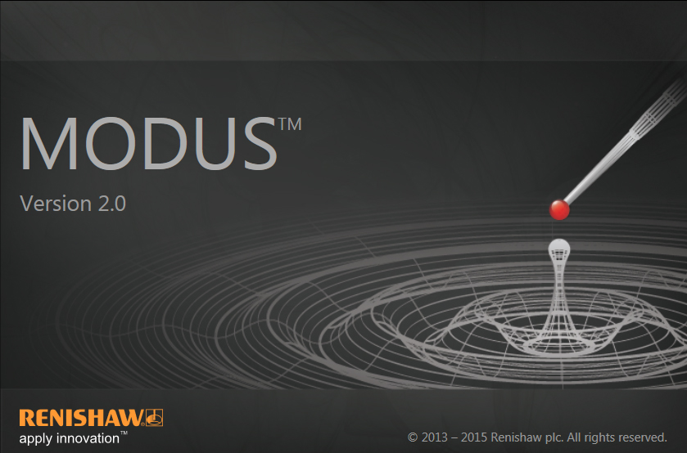
MODUS 2

Slide 2
What is MODUS 2?
The MODUS 2 metrology software suite brings new levels of clarity and efficiency to the programming and operation of CMMs.
Designed with usability in mind, its clean interface is quicker for new users to learn, and faster to program.
Advanced algorithms calculate the most efficient measurement path across multiple axes, significantly accelerating collision-free motion.
As a result you can measure and inspect the critical features of more
parts in less time.
MODUS 2 gives you timely process feedback - ensuring manufacturing
to the highest specifications within today’s tighter timescales.

Slide 3
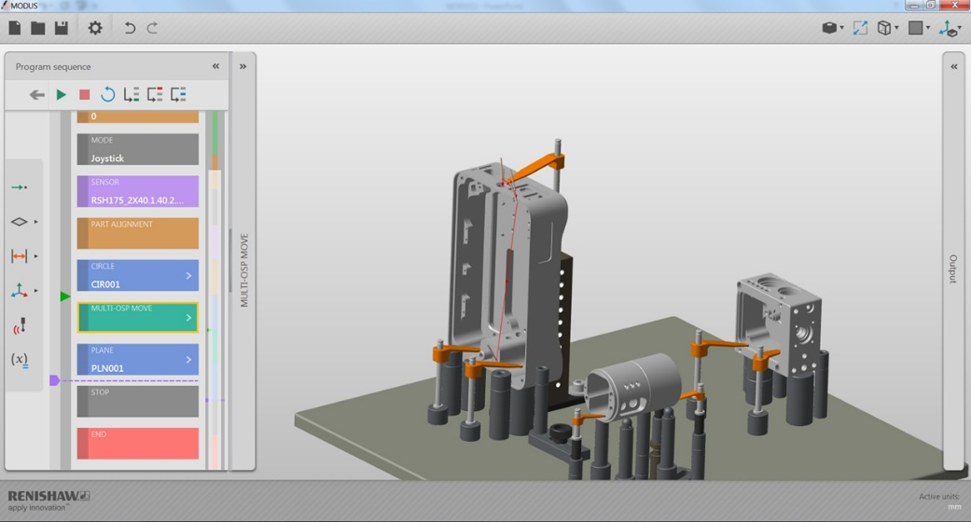
Clarity
MODUS 2 features a node-based interface to reduce on-screen clutter. This clean design with its colour-coded section enables new users to rapidly become familiar with the system.
Operators can clearly identify and
amend sequence details without
searching through countless lines
of complex code.

Slide 4
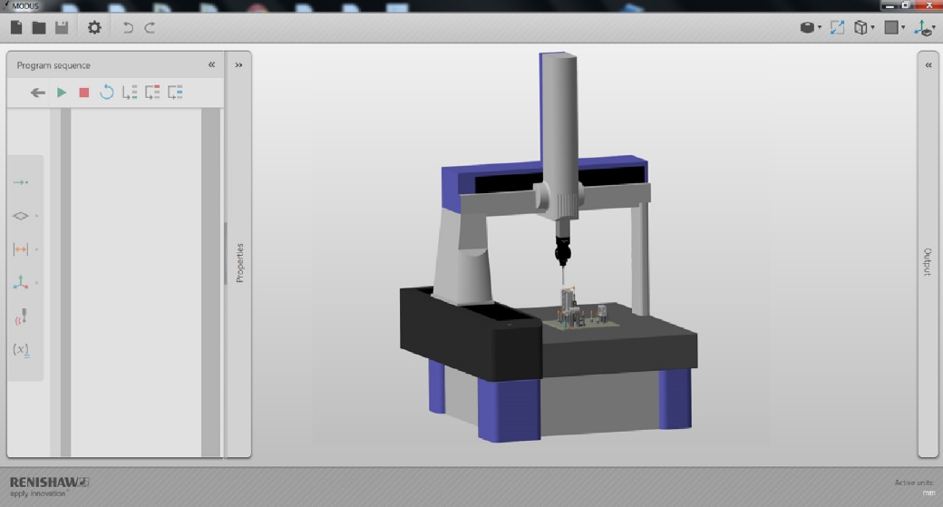
Usability
CAD models and the CMM environment itself are manipulated using direct interaction techniques.
Potential issues are highlighted on screen - the need for confirmation of actions in dialogue boxes has been removed.
Streamlined data entry and coding;
inspection sequences for even the
most complex workpieces are
simpler to set up.

Slide 5
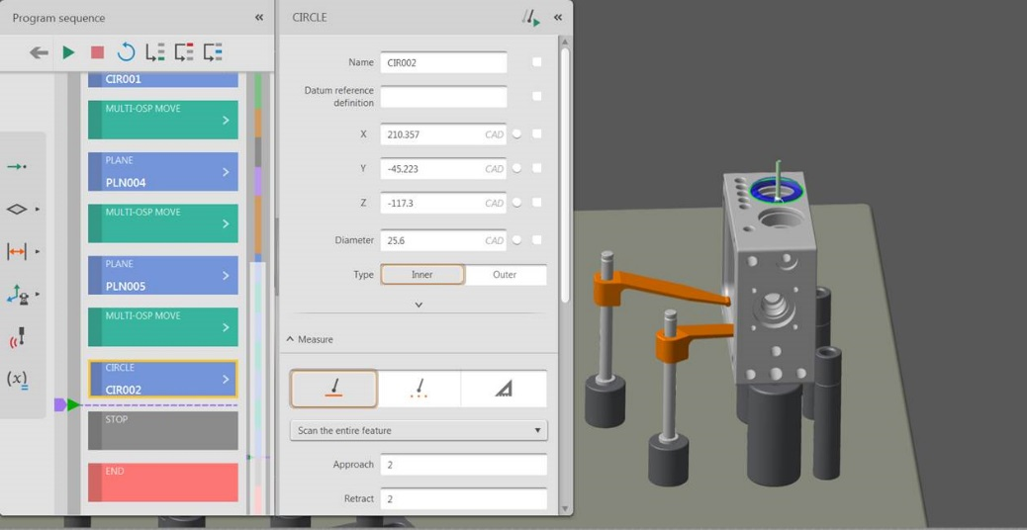
Efficiency
To save time MODUS 2 automates the intelligent extraction of CAD data, as well as enabling useful code sequences to be stored and reused.
As a result, individual users can now collaborate to develop one measurement strategy to be applied consistently across their organisation
Powerful off-surface motion planning
algorithms generate efficient collision-
free measurement paths around a
workpiece.
These paths can be tested and
tweaked on screen using the
simulation feature.

Slide 6
Technical specification
Full support for I++ DME compliant metrology controllers, including Renishaw's UCC range of universal CMM controllers
Full compatibility with 5 axis systems: PH20 and REVO
CAD-driven offline programming, with support for neutral formats of IGES, STEP, Parasolid®, and VDA-FS
High quality integration with CATIA® (v5 and v4), Siemens® NX™ (previously Unigraphics®), Pro/E® and Solidworks® CAD / CAM solutions
Off surface planning for collision free measurement paths, including 5-axis paths

Slide 7
Technical specification
Full motion simulation and path adjustment capability
Native DMIS support
Certified mathematical algorithms
Powerful text and graphical reporting
Flexible output of results data including certified Q-DAS

Slide 8
MODUS 2
Thank you for your
attention…

