Slide 1
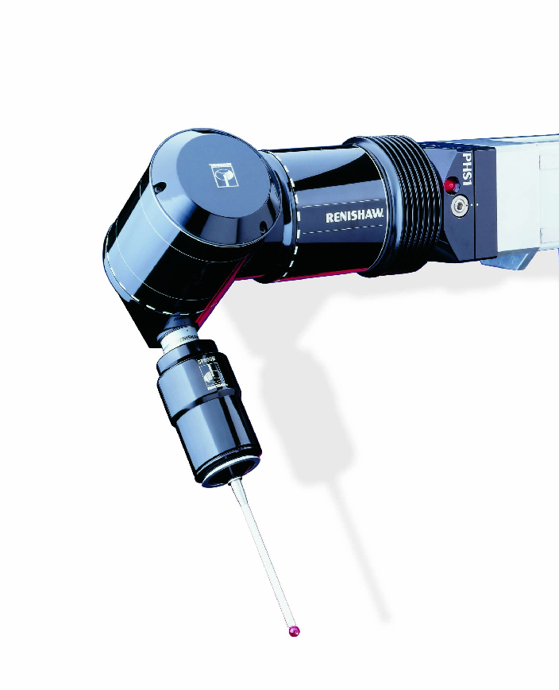
PHS1
Servo positioning head

Slide 2
What is the PHS1?
The PHS1 is a servo positioning head used for mounting and articulating probes when inspecting assembled components.
This means that the head can move to an infinite number of positions thereby increasing flexibility and accessibility over indexing heads.

Slide 3
Where is it used?
The PHS1 is best suited to production line inspection of assembled components and is mainly used within the automotive industry.
The PHS1 mounts directly to a horizontal arm machine and is ideal for inspecting large complex parts with restricted access.

Slide 4
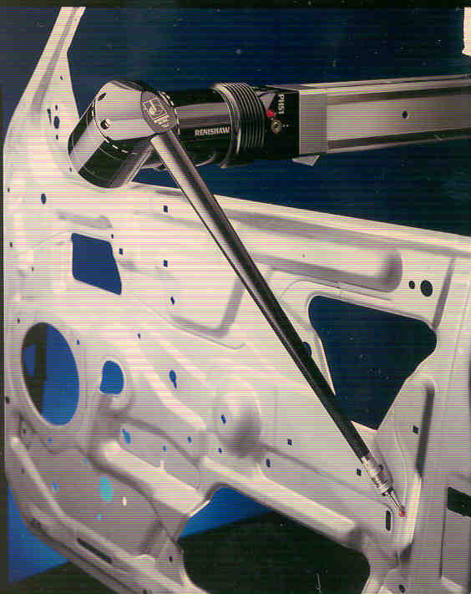
Where is it used?
Specific PHS1 applications include:
Automotive
Car ‘body in white’ inspection
Pressed sheet metal assemblies
Large moulded composite components
Car chassis alignment
Car trim (optical probing is used for easily deformed components)
Aerospace
Precision fabricated structures

Slide 5
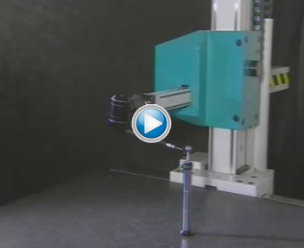
PHS1 in action
Infinitely variable positioning
PHS1’s motion can be combined with the CMM
motion to generate blended
5-axis moves.

Slide 6
Why do you need it?
The PHS1 system brings many benefits that will improve the way you inspect assemblies.
These benefits include:
Flexibility
Increased throughput
Maximum accessibility
Improved accuracy
Minimal risk to head and CMM
Low cost of ownership

Slide 7
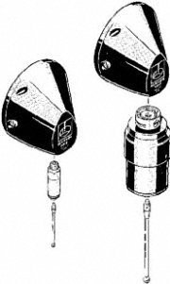
Why do you need it?
Flexibility
Compatible with multiple probing types:
Touch-trigger (TP20, TP200)
Scanning (SP600M)
Automatic arm changing:
Modular system
Port pairs mounted on standard extrusion pillar
Position any number of racks anywhere on CMM
No wiring necessary

Slide 8
Why do you need it?
The PHS1 system brings many benefits that will improve the way you inspect assemblies.
These benefits include:
Flexibility
Increased throughput
Maximum accessibility
Improved accuracy
Minimal risk to head and CMM
Low cost of ownership

Slide 9
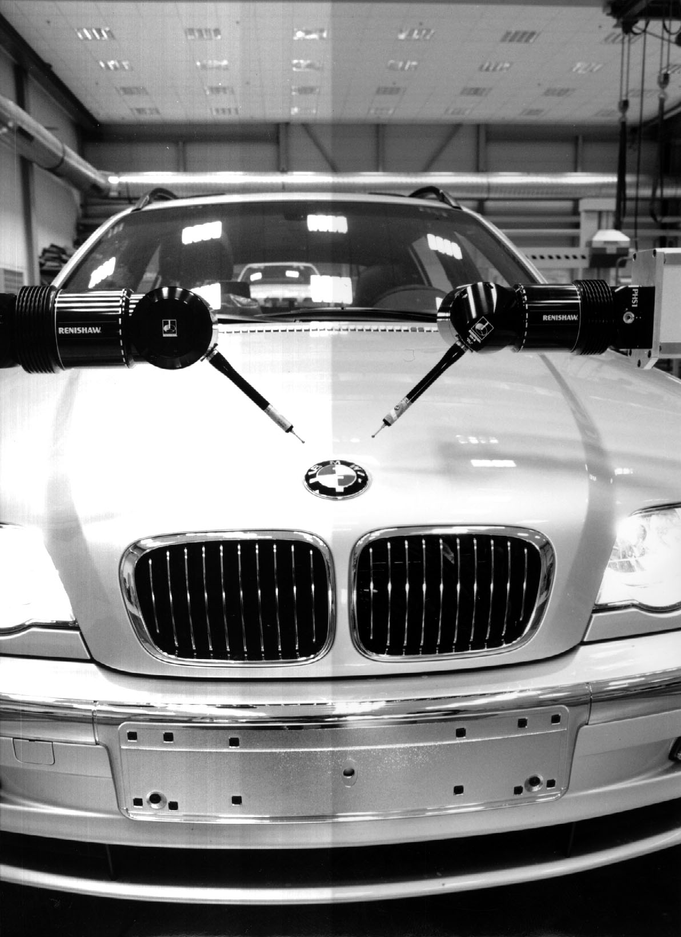
Why do you need it?
Increased throughput
Servo positioning heads reduce qualification and cycle times and give maximum component accessibility
Throughput can be increased by running multiple installations simultaneously
Rapid automatic arm changing eliminates the need for manual intervention allowing machines to run unattended
All locking and unlocking is executed by the motion of the CMM

Slide 10
Why do you need it?
The PHS1 system brings many benefits that will improve the way you inspect assemblies.
These benefits include:
Flexibility
Increased throughput
Maximum accessibility
Improved accuracy
Minimal risk to head and CMM
Low cost of ownership

Slide 11
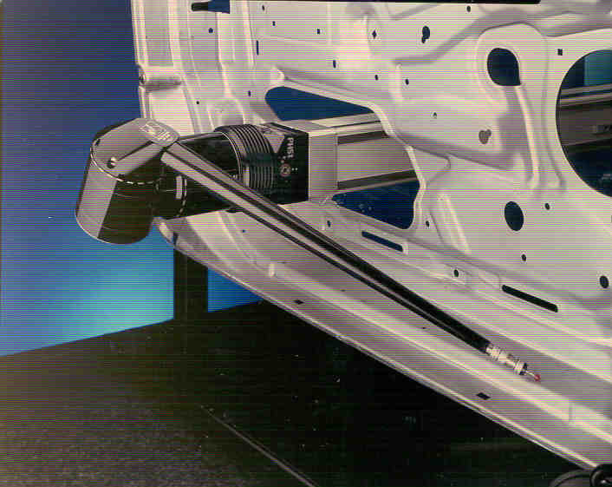
Why do you need it?
Accessibility
+/-180 degree drive in both axes allows maximum positioning of head
Continuous positioning, long reach and synchronised motion enables access to complex parts at almost any angle and in restricted spaces
Long extensions facilitate measurement in previously inaccessible areas
Simultaneous motion with the CMM permits access through restrictive workpiece features

Slide 12
Why do you need it?
The PHS1 system brings many benefits that will improve the way you inspect assemblies.
These benefits include:
Flexibility
Increased throughput
Maximum accessibility
Improved accuracy
Minimal risk to head and CMM
Low cost of ownership

Slide 13
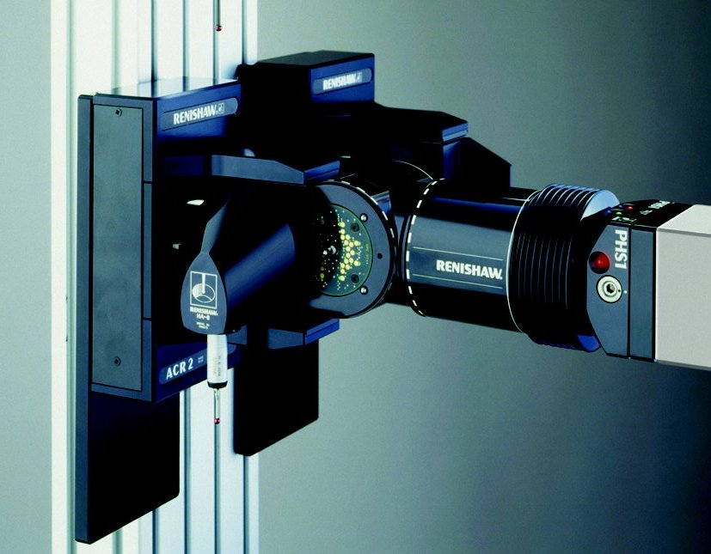
Why do you need it?
Accuracy
PHS1 is capable of reading position to within 0.2 arc second angular resolution (0.1 µm at 100 mm radius)
Tolerances typically required are all well within the capabilities of the PHS1 system at its longest reach

Slide 14
Why do you need it?
The PHS1 system brings many benefits that will improve the way you inspect assemblies.
These benefits include:
Flexibility
Increased throughput
Maximum accessibility
Improved accuracy
Minimal risk to head and CMM
Low cost of ownership

Slide 15
Why do you need it?
Minimal risk to head and CMM
PHS1 is not locked in position but is driven to
position within a target window through
synchronisation with the axes of the CMM
As the probing point is taken the head simultaneously latches with the CMM axes
A unique swash map is included with each PHS1. If required, this swash map compensates for the individual head characteristics when the CMM is error mapped
Integral overtravel protects the PHS and CMM should accidental collision occur

Slide 16
Why do you need it?
The PHS1 system brings many benefits that will improve the way you inspect assemblies.
These benefits include:
Flexibility
Increased throughput
Maximum accessibility
Improved accuracy
Minimal risk to head and CMM
Low cost of ownership

Slide 17
Why do you need it?
Low cost of ownership
The PHS1 system is completely modular and each item within the system is individually priced
Renishaw offers a wide range of service options for all their products in order to minimise the customers downtime
The cost of the repair is determined from the extent and nature of the damage
The customer also has the option of purchasing a replacement from the repair by exchange scheme

Slide 18
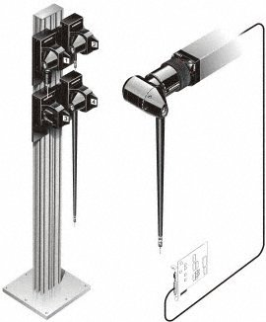
PHS1 system
The PHS1 system comprises:
PHS1 head (with swash map)
Arm adapters (M8 and autojoint)
PHS1 arms (330 mm, 500 mm and 750 mm)
Autochange rack
PC interface card
PHS1 is integrated by OEM into CMM controller

Slide 19
Summary
With PHS1 you can:
Measure using touch-trigger, optical and scanning probes depending on your application
Infinitely position your stylus reducing qualification and cycle times
Increase throughput by running multiple installations simultaneously
Automatically change arm lengths up to 750 mm long for increased accessibility (all through motion of CMM)

Slide 20
Summary
With PHS1 you can:
Read the position of the head to 0.2 arc second angular resolution
Protect your investment through integral overtravel protection
Be assured that any machine downtime will be kept to a minimum through Renishaw’s expert service and support
Interchange between PH10 PLUS and use the same part programs (see PH10 PLUS presentation for more information)

Slide 21
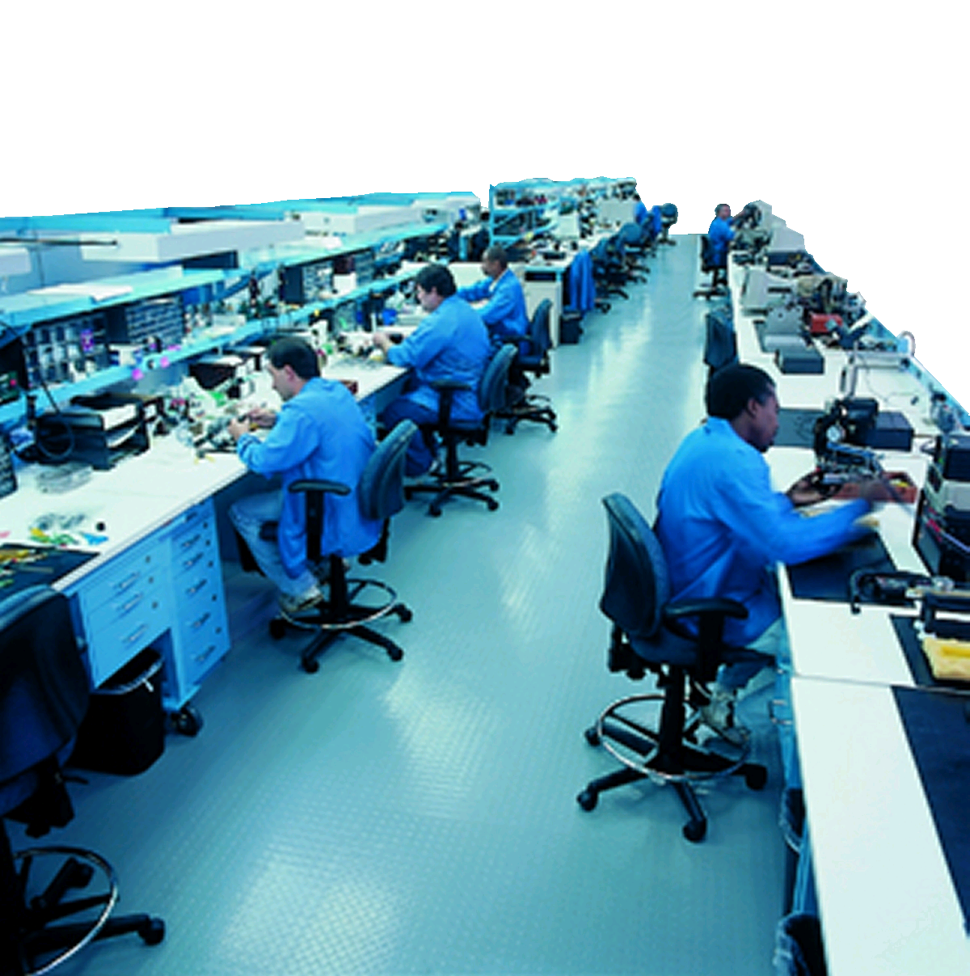
Responsive service and expert support
Application and product support wherever you are
  Renishaw has offices in over 32 countries
  Responsive service to keep you running
  Optional advance RBE (repair by exchange) service on many products
    We ship a replacement on the day you call
  Troubleshooting
  and FAQs on
  www.renishaw.com/support

Slide 22
PHS1
Servo positioning head
Thank you for your attention…

