Slide 1
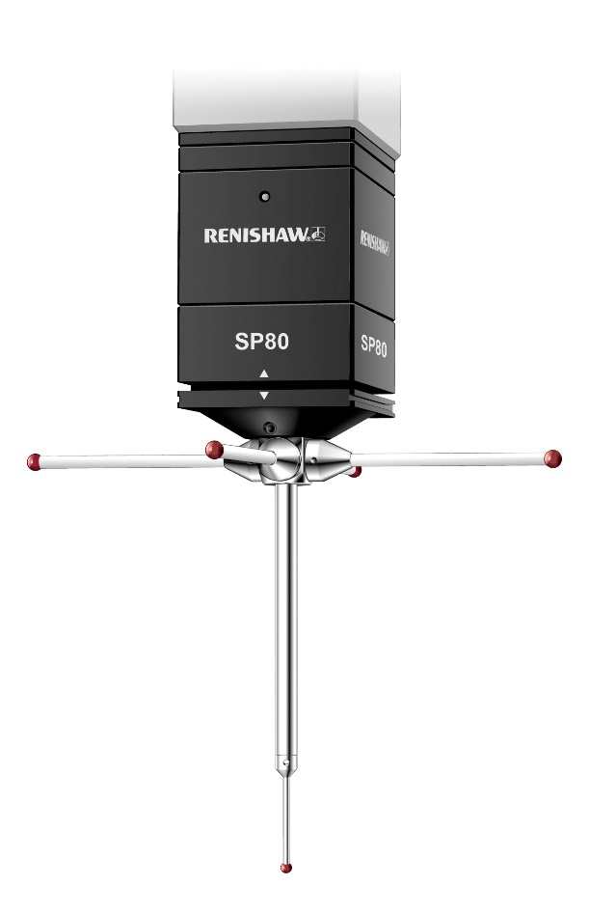
SP80 and SP80H

Slide 2
SP80 and SP80H design principles
Renishaw's design brief for SP80 and SP80H:
Very accurate position sensing
Long reach into parts
Passive design to avoid unnecessary system complexity
Designed to avoid stacked axis errors
Stylus changing capability for reduced cycle times
Both probe types use the same design principles
Notes:
Renishaw’s SP80 adheres to all the design principles of Renishaw’s ‘passive’ sensor technology.

Slide 3
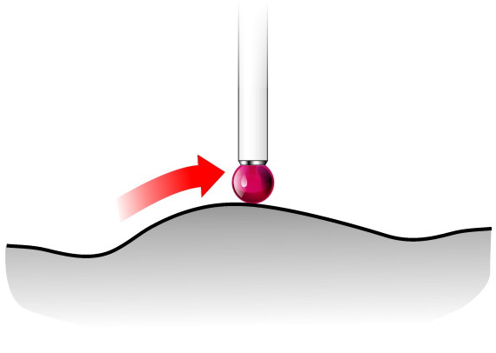
SP80 and SP80H design principles
SP80 is a PASSIVE sensor (as opposed to an ACTIVE sensor type) so its features are:
Simple, accurate and high-performance design
Robustness and high resistance to most collision damage
Use of long, heavy, complex and rapidly interchangeable styli
Long service life, reliability and low cost of ownership

Slide 4
SP80 and SP80H design principles
SP80 is an ANALOGUE scanning probe:
Giving a continuous reading at any time while in contact with the part
An integral part of the CMMs motion control system - real time X, Y and Z outputs
A probe whose output is proportional to its deflection

Slide 5
SP80 and SP80H design principles
Passive sensor - no motors
Minimal heat source for greater stability
No electro-mechanical wear
Reduced vibration during discrete point measurement
Notes:
It is always sensible to minimise stylus length to reduce stylus bending and to minimise suspended mass, thus maximising the dynamic response of the probe.

Slide 6
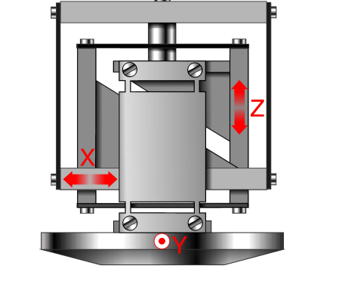
SP80 and SP80H design principles
Box spring mechanism
Unique design
Compact and robust mechanism
Low inertia
Rapid dynamic response
Low spring rates
Single 3D ferro-fluid damper
Avoids stacked axis errors
Parallel acting springs
Notes:
It is always sensible to minimise stylus length to reduce stylus bending and to minimise suspended mass, thus maximising the dynamic response of the probe.

Slide 7
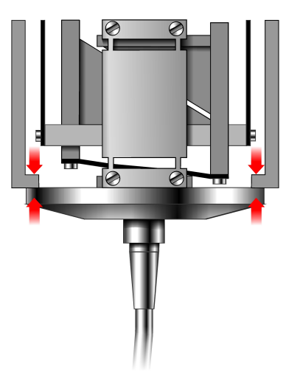
SP80 and SP80H design principles
XY crash protection
Stylus holder joint has low release force
Over-travel in XY causes stylus holder to detach
Z crash protection
Outer housing provides a ‘bump stop’ to prevent damage to probe mechanism and readhead
Stylus deforms in a severe Z crash, whilst probe mechanism is protected
Notes:
Renishaw's kinematic stylus changing system provides crash protection when the stylus travel is exceeded in a lateral direction (X or Y). However, this does not provide full protection for crashes in the Z direction.
A feature of Renishaw scanning probes is a Z 'bump stop' that transfers any compression forces into the probe body before the Z travel of the scanning mechanism is exceeded. This means that in the event of an uncontrolled Z movement of the machine, the probe stylus and the probe body take the load whilst protecting the box spring and readheads from damage.
SP80H
SP80H is a horizontal version of the box mechanism described above therefore the crash protection works in exactly the same way. Take the probe coordinates as X,Y,Z and keep them the same just rotate the probe accordingly ie.
X = lateral movement
Y = lateral movement
Z = in and out

Slide 8
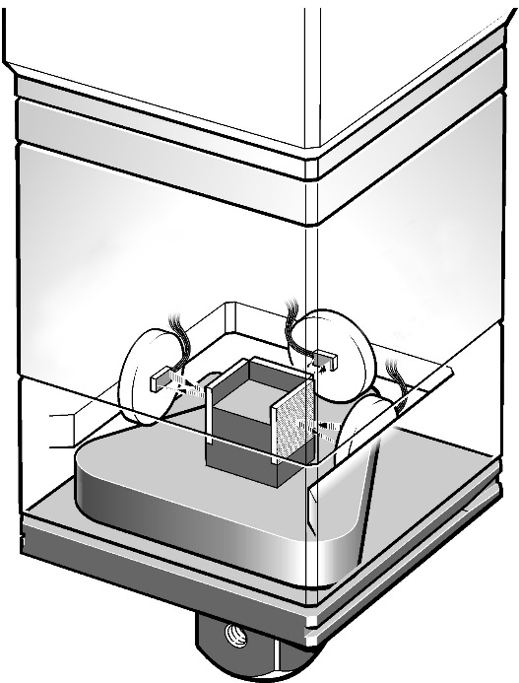
SP80 and SP80H design principles
Isolated optical metrology
Readheads attached to probe housing
Measures deflection of whole mechanism, not just one axis:
Eliminates inter-axis errors
Picks up thermal and dynamic effects
SP80 avoids inter-axis error
Notes:
A scanning probe has three axes of deflection - X, Y and Z. The SP80 uses parallel-acting springs to allow each axis to move relative to one another. Each axis moves in an arc, resulting in a small amount of motion in a direction perpendicular to the axis that is moving. This small deflection - or inter-axis error - must be accounted for to ensure that the position of the stylus is accurately known.
In the SP80, the three axes are arranged to form a unique 'box spring', making for a very compact design. The transducer (position sensing) system is located behind the spring assembly.
Isolated optical metrology
Renishaw's SP80 probe mechanism features a transducer system with readheads fixed to the body of the probe, measuring the deflection in each direction on a target mounted to the moving mechanism. This arrangement means that any inter-axis errors caused by the arc motion of each pair of parallel-acting springs are directly measured by the sensor system - the deflection in each direction is measured 'back to earth'. The motion of the stylus is measured directly by the readheads, meaning that the system is not reliant on the mechanical design of the structure for its accuracy.
The illustration on this slide shows a schematic of an SP80 mechanism featuring position sensitive detectors (PSDs) lit by LEDs shining through precision slits.
By contrast, probes that feature position sensing devices mounted to each axis can only measure linear deflections relative to the axis above. They cannot detect inter-axis errors, nor errors of squareness of the probe axes. Whilst these errors can be compensated, this is not necessary for a Renishaw scanning probe.
Isolated optical metrology systems can detect sources of variable error such as thermal and dynamic effects. Stacked axis probes cannot detect these and so perform less well in real world conditions, or when scanning quickly.

Slide 9
SP80 and SP80H design principles
Probes with stacked axes cannot measure inter-axis errors directly
SP80 features digital readheads with 0.02 μm resolution reading precision gratings
accuracy defined by straightness of lines on each grating and calibrated squareness of gratings, not by probe mechanical design
Notes:
The SP80 also features isolated optical metrology. The larger size of this probe allows for a more sophisticated sensor system - the SP80 uses digital readheads and precision gratings as the basis for its position feedback. This allows for even greater precision.
The digital readheads are each matched to a grating, which contains a series of precisely straight and parallel lines. Three gratings are attached to the moving mechanism, each one aligned with an axis of motion. The squareness of these gratings is calibrated, so that any slight misalignments are corrected in the probe output. The readheads interpolate the signal from the gratings to produce a digital output at 20 nm resolution.
The accuracy of the overall {x.y.z} deflection of the probe is reliant on the straightness of the lines on the grating surface, and on the performance of the readheads, not on the design of the probe mechanism. The performance results speak for themselves.
NOTE: ISO Tij is the result generally quoted for scanning probes. It is the total span of readings in the measured data set. Renishaw also quotes ISO Diff values - the maximum radial error from the calibrated perfect sphere to the measured values.
Note that these results are for unknown path scans and are raw data with no filter applied. When a 60 Hz harmonic filter is used, the Tij value for SP80 in this test fell to 0.6 microns.
Other details for the ISO test:
Scanning speed = 5 mm/sec
Scanning deflection = 0.5 mm
Total points taken = 2,619

Slide 10
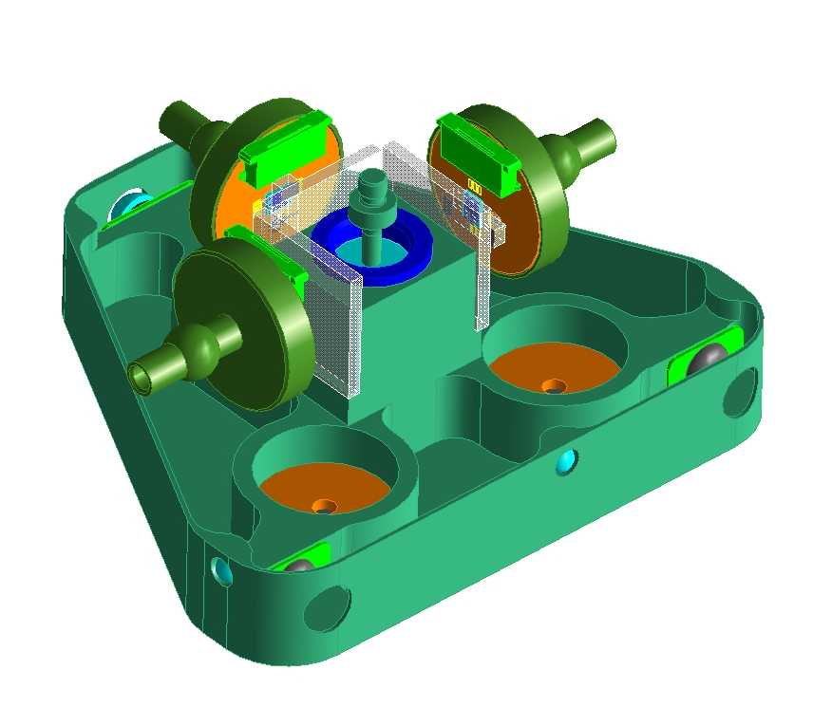
SP80 and SP80H design principles
Readhead arrangement
X
Z
Y

Slide 11
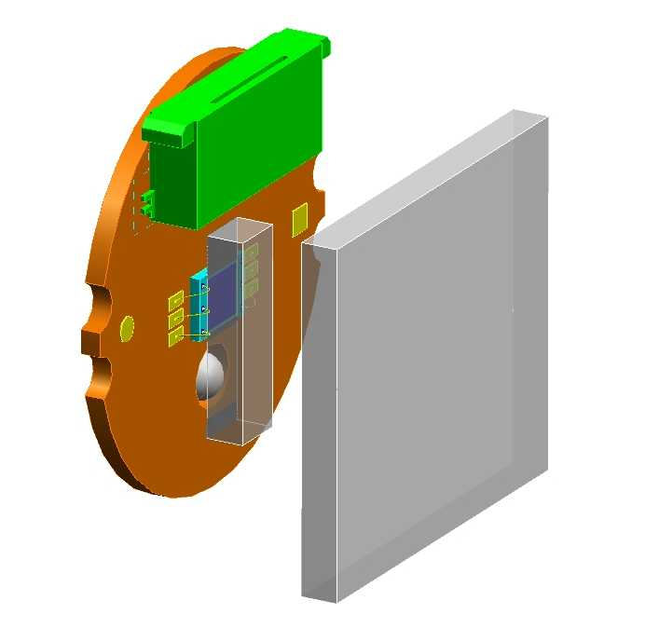
SP80 and SP80H design principles
SP80 readhead operating range
Standoff
1 mm to 7 mm
6 mm (XY)
(7 mm (Z)

Slide 12
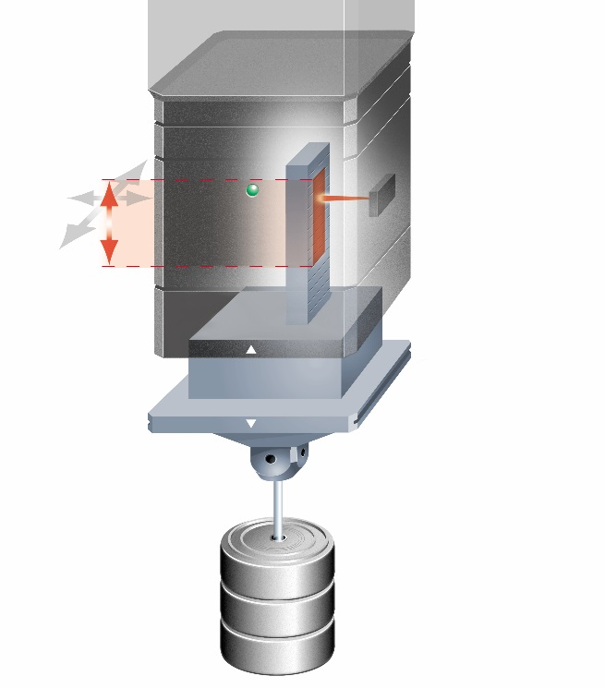
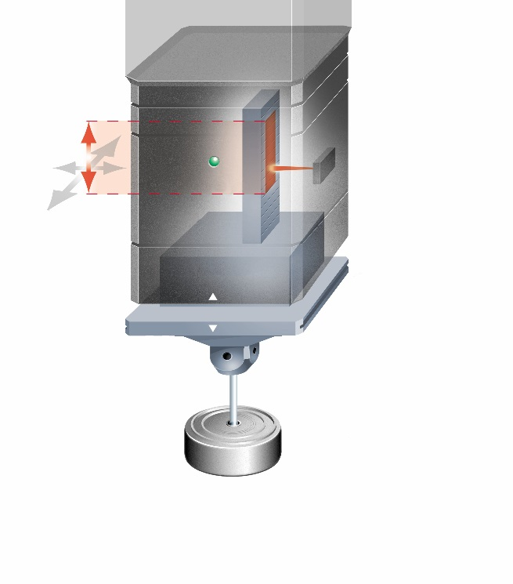
SP80 and SP80H design principles
Readheads permit a large operating range on SP80…
+ 4.5 mm
Fixed probe body with integral readhead
+ 2.5 mm
Fixed probe body with integral readhead
7 mm ‘Z’ operating
range
7 mm ‘Z’ operating
range
Reflective scale
Reflective scale
- 4.5 mm
- 2.5 mm
Moving structure*
Moving structure*
Min stylus mass
Max stylus mass
* Stylus holder and reflective scale move together
Notes:
The SP80 enables long styli to be carried.

Slide 13
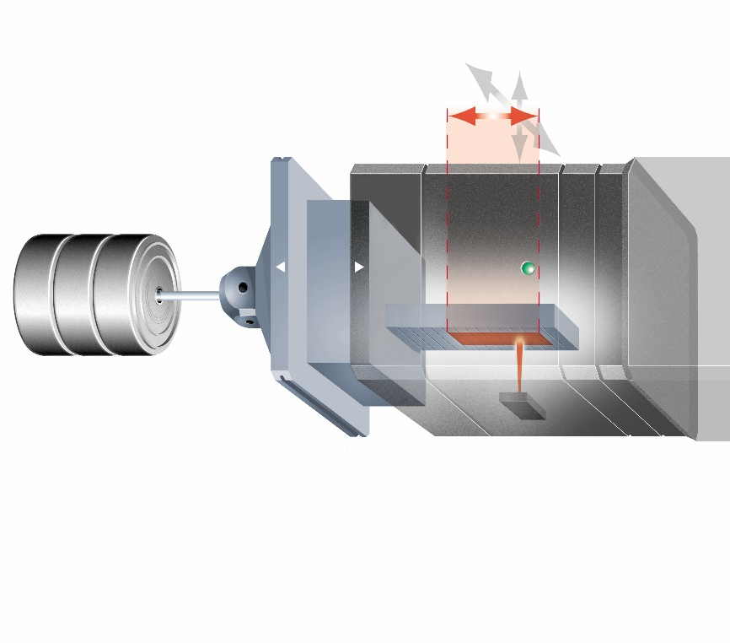
SP80 and SP80H design principles
…and on SP80H
2 mm ‘Z’ operating range
4 mm ‘Z’ operating range
-3.25 mm
+1.25 mm
-0.75 mm
+1.25 mm
Fixed probe body with integral readhead
Min stylus mass
Fixed probe body with integral readhead
Max stylus mass
Reflective scale
Moving structure*
Moving structure*
Reflective scale
* Stylus holder and reflective scale move together
Notes:
The SP80H enables long styli to be carried.

Slide 14
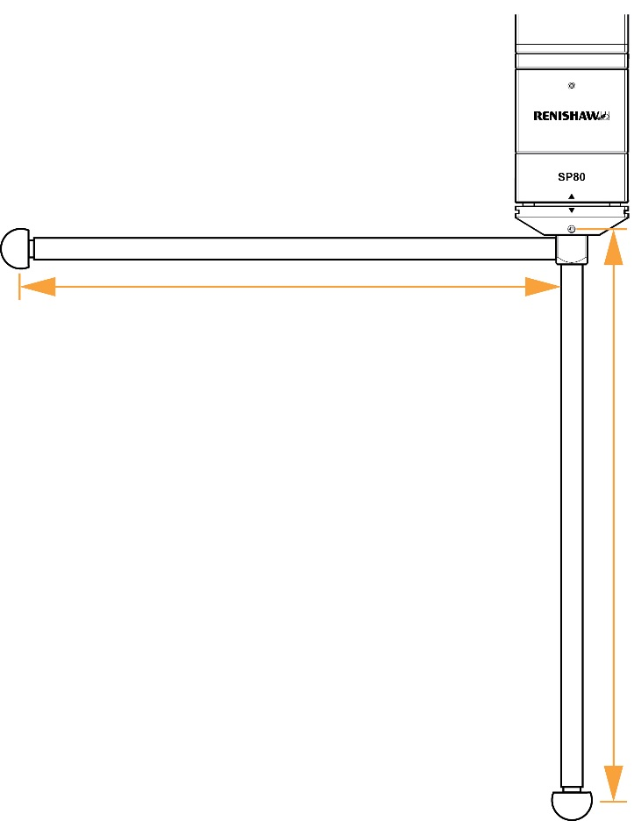
SP80 and SP80H design principles
SP80 maximum stylus carrying capability
Maximum unidirectional length 1000 mm (using SH80 EXT)
Maximum load 500 g with no -Z range compromise
>500 g reduces -Z range
Styli thread M5
Up to 1000 mm
(unbalanced)
Up to 1000 mm
Notes:
The SP80 enables long styli to be carried.

Slide 15
SP80 and SP80H design principles
SP80H maximum stylus carrying capability
Maximum unidirectional length 500 mm
Maximum stylus weight 200 g with centre of gravity 100 mm max from stylus holder cube
Styli thread M5
Up to 500 mm (subject to weight restriction)
Up to 500 mm
(subject to weight restriction)
Notes:
The SP80H enables long styli to be carried.

Slide 16
SP80 - scanning performance (up to 1000 mm stylus)

Slide 17
SP80 and SP80H specification summary
Mounting Vertical fixed quill mount with options:
KM80 standard mount method
KM6080 adapts down to 60 mm × 60 mm quill
SM80 shank mount - non-preferred
Probe physical size 80 mm square body
105 mm long including SH80
Probe mass SP80 probe body 860 g (incl. 160 g moving structure)
SH80 stylus holder 170 g (excl. stylus)
KM80 quill mount 110 g
Notes:
The SP80H enables long styli to be carried.

Slide 18
SP80 and SP80H specification summary
Calibration method Simple 1st order polynomial (3 × 3 matrix)
SP80 nominal spring rate 2 N/mm X,Y,Z
SP80H nominal spring rate 1.8 N/mm X,Y
2.5 N/mm Z
Readhead resolution Digital scales capable of 0.02 µm
SP80 measurement range ±2.5 mm X,Y,Z (even with up to 500 g styli mass)
SP80H measurement range ±2.5 mm X,Y
±1.25 mm Z (stylus limitations apply)
Notes:
The SP80H enables long styli to be carried.

Slide 19
SP80 and SP80H
Thank you for your attention…

