Slide 1
Renishaw touch-trigger probing technology
Rugged and flexible solutions for discrete point measurement on CMMs
Notes:
The presentation explains how Renishaw designs its touch-trigger probing systems, providing comparisons between various Renishaw’s solutions.

Slide 2
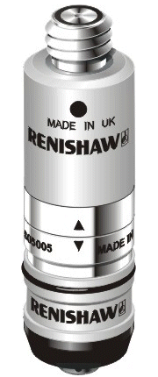
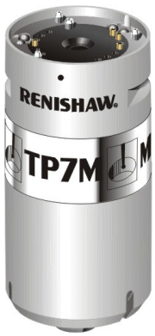
Touch-trigger probe technologies
Resistive
Simple
Compact
Rugged
Strain-gauge
Solid-state switching
High accuracy and repeatability
Long operating life
Notes:
All Renishaw probes use a kinematic mechanism to retain the stylus and to provide overtravel. However, the method of trigger sensing varies from model to model.
Three main sensing technologies:
Resistive - the original design of touch-trigger probe, in which a kinematic mechanism also provides the trigger sensing. These probes are simple, cost-effective, very compact and rugged.
Strain-gauge - silicon gauges measure the contact force and trigger once a threshold is breached. This provides a consistent and highly repeatable trigger characteristic, eliminating the ‘lobing’ effects of resistive probes. Solid-state switching is inherently more reliable than electro-mechanical switching, mean that strain-gauge probes have much longer operational lives.

Slide 3
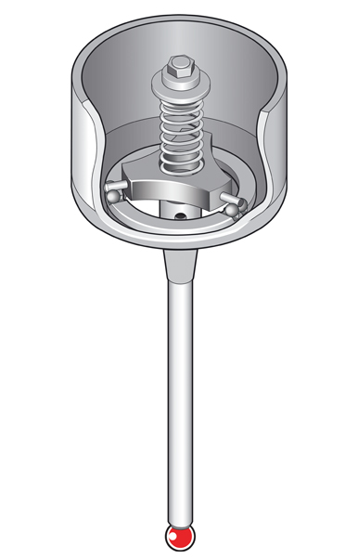
Kinematic resistive probe operation
A trigger signal is generated
on contact with the component
surface and is used to stop
the machine
A spring holds the stylus
against the kinematic contacts
and returns the probe to a
seated position following
contact between the stylus
and the part
Three rods, each resting on two
balls, providing six points of contact
in a kinematic location
The stylus ball is uniquely located,
returning to the same position to
within 0.00004 “ (1 micron)
Notes:
In a kinematic resistive probe, the stylus is located such that all degrees of freedom are constrained by six points of contact between a set of spheres and cylinders. The diagram shows a typical kinematic mechanism.
A spring holds the stylus carrier against a ball plate that is fitted to the probe housing. The ultra-hard contacts ensure that there is little deformation of the surfaces under the retaining spring force. An electrical circuit runs through the six contacts and the electrical resistance is monitored.
When the probe stylus contacts the surface, this force acts against the retaining spring and causes one or two pairs of the contacts to move apart. As the force between the kinematic contacts reduces, the contact patch between the elements gets smaller. As a result, the electrical resistance around the circuit increases. It is this change that is sensed by the probe electronics.
The elegance of the kinematic resistive sensor is that it combines a mechanically repeatable location and electrical sensing in a simple mechanism. Kinematic trigger probes can be very compact, whilst their robust design makes them suitable for most measurement applications.
The arrangement of contacts means that the force required to trigger the probe in the XY plane varies depending on the direction of contact. This varying force causes the stylus to deflect by a different amount when the trigger occurs. This characteristic - called ‘lobing’ or pre-travel variation (PTV) - can be easily compensated through probe calibration.
The PTV effect is more severe during 3D contacts - i.e. where the probe meets the surface along a compound vector in all three axes. This makes kinematic resistive probe unsuitable for complex digitising applications.

Slide 4
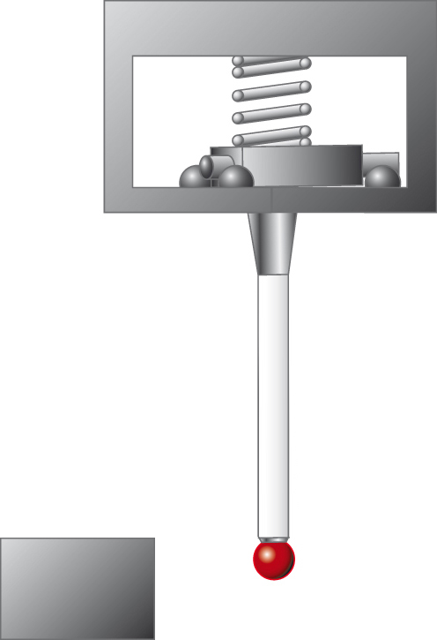
Kinematic resistive probe operation
Probe in seated position
All kinematics in contact
Motion of
machine
Notes:
This slide shows the actions of the probe mechanism during a trigger.
The probe is in free space and the mechanism is seated.
Once the stylus touches the component, contact forces start to build. At first, the spring in the probe mechanism holds the kinematic contacts together. The contacts remain seated until the point where the spring force reaches a threshold level where the moment generated by the contact force match the resistive moment generated by the spring.
Before this point of equilibrium is reached, the contact force causes the stylus to bend by a small amount (depending on the probe spring rate, the stylus stiffness and the stylus length).
When the contact moment exceeds the resistive moment, the kinematic contacts start to separate. An increase in resistance across the contacts causes a trigger signal to be generated, and the current to be cut off, before the contacts separate.
The machine then stars to decelerate, with the probe mechanism continuing to deflect to accommodate this movement.
Finally, the machine backs off the part, allowing the mechanism to reseat and the stylus to return to its repeatable location.

Slide 5
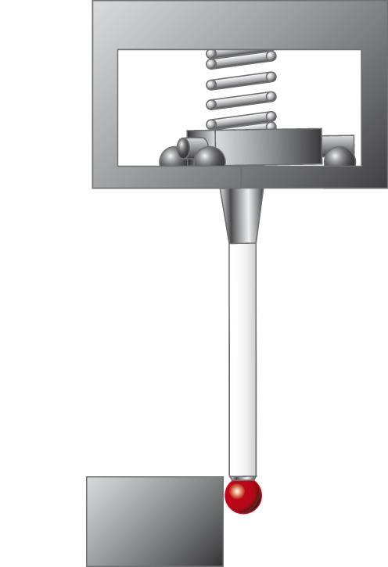
Kinematic resistive probe operation
Probe in seated position
Stylus makes contact with component

Slide 6

Kinematic resistive probe operation
Probe in seated position
Reactive force
Stylus makes contact with component
Contact force resisted by reactive force in probe
mechanism resulting in bending of the stylus
Contact force

Slide 7
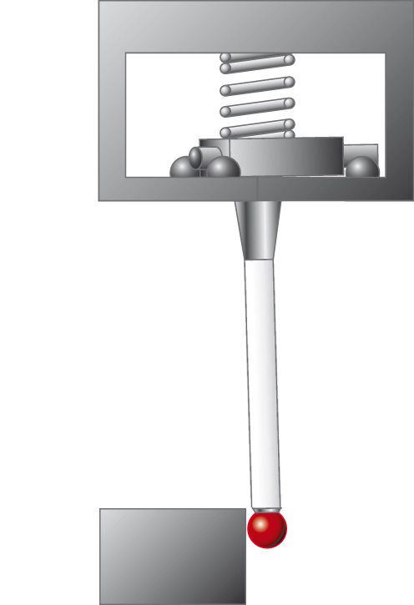
Kinematic resistive probe operation
Probe in seated position
Pivot about these contacts
Contacts separate
Stylus makes contact with component
Contact force resisted by reactive force in probe
mechanism resulting in bending of the stylus
Stylus assembly pivots about kinematic contacts,
resulting in one or two contacts moving apart
  Trigger generated before contacts separate

Slide 8
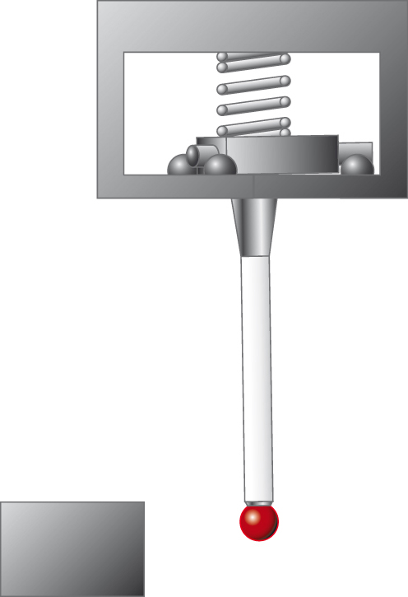
Kinematic resistive probe operation
Probe in seated position
Stylus makes contact with component
Contact force resisted by reactive force in probe
mechanism resulting in bending of the stylus
Stylus assembly pivots about kinematic contacts,
resulting in one or two contacts moving apart
  Trigger generated before contacts separate
Machine backs off surface and probe reseats

Slide 9
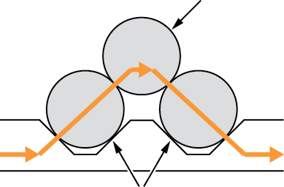
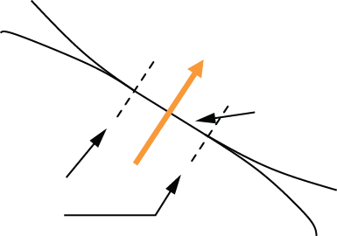
Kinematic resistive probe operation
Kinematic attached to stylus
Section through kinematics:
Electrical switching
Electrical circuit through contacts
Resistance measured
Contact patches reduce in
size as stylus forces build
Current flows
through kinematics
Kinematics bonded to (and
insulated from) probe body
Close-up view of kinematics:
Resistance rises as area reduces (R = ρ/A)
Contact patch shrinks as stylus force balances spring force
Elastic deformation
Notes:
The probe control circuit continuously monitors the resistance through the kinematic contacts. At rest, the kinematics are pressed together by the retaining spring, causing a small amount of elastic deformation where the contacts meet. The resistance of the circuit is controlled by the size of these contact patches between the kinematics and the resistivity of the material from which they are made (R = ρ/A).
When the stylus strikes the surface, the force of contact starts to acts against the spring force. Before the stylus starts to pivot, this has the effect of reducing the elastic deformation of some of the contacts. Reducing the contact area increases the resistance.

Slide 10
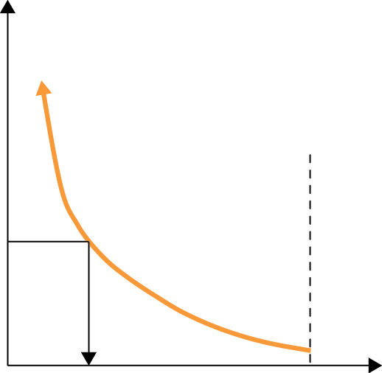
Kinematic resistive probe operation
Electrical switching
Resistance breaches threshold and probe triggers
Kinematics are still in contact when probe triggers
  Stylus in defined position
Current cut before kinematics separate to avoid arcing
Resistance
Force on kinematics when stylus is in free space
Trigger threshold
Trigger signal generated
Force on kinematics
Notes:
The probe control circuit generates a trigger signal once the resistance exceeds a resistance threshold. It is important to note that the probe triggers whilst the kinematics are still in contact (i.e. the is still a force holding all the sets of kinematics together) and before any pivoting occurs. This means that the stylus is in a defined location at the point of trigger. Once the contacts separate, the stylus is unconstrained.
The probe control circuit cuts the current through the kinematics as soon as a trigger is generated. This means that there is no potential across the contacts when they separate. This avoids arcing across the small air gap immediately after the contacts separate, ensuring a longer operating life for the sensor.

Slide 11
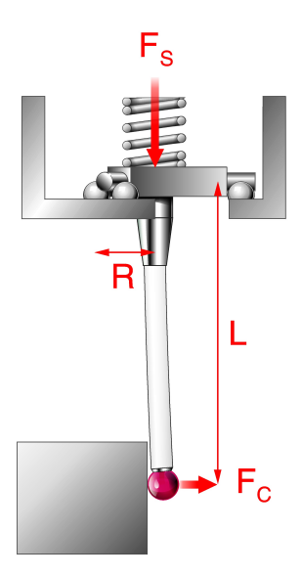
Factors in measurement performance
Pre-travel
Stylus bending under contact loads before trigger threshold is reached
Pre-travel depends on F_{C} and L
Trigger is generated a short distance after the stylus first touches the component
F_{C} × L = F_{S} × R
L and F_{S} are constant
∴F_{C} is proportional to R
Notes:
This slide highlights the forces that are in action during the trigger process. The contact force F_{C} generates a moment about the kinematics, resisted by the spring force F_{S}. The point of equilibrium is reached when the moment generated by F_{C} x L matches that generated by F_{S} x R.
The load F_{C} causes the stylus to bend. The amount of bending prior to the point that a trigger occurs depends of the magnitude of F_{C} needed to overcome the spring force, plus the length and stiffness of the stylus.
The amount of stylus bending at the point that a trigger occurs is known as the pre-travel.
The pre-travel is direction-dependent, since it depends on the lever arm over which the spring force acts (R). As will be seen on the next slide, R changes depending on which direction the contact force acts relative to the probe mechanism, meaning the magnitude of the contact force needed to trigger the probe also varies with probing direction.

Slide 12
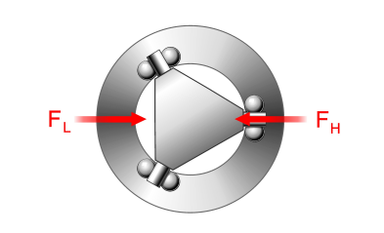
Factors in measurement performance
Pre-travel variation - ‘lobing’
Trigger force depends on probing direction, since pivot point varies
  F_{C} is proportional to R
Therefore, pre-travel varies around the XY plane
Top view
Notes:
The diagram (top right) shows a plan view of the kinematics. The direction of the contact force relative to this triangular arrangement of contacts will determine about which points the mechanism pivots.
In the high force direction, the mechanism must pivot about a single contact. In the low force direction, the mechanism pivots around two contact pairs. The value of R₁ is twice that of R₂, meaning that the spring has greater mechanical advantage in the high force direction and therefore demands a higher contact force to trigger the probe.
A higher contact force results in greater pre-travel in the high force direction. The range of pre-travel as the contact direction varies in the XY plane is known as the XY pre-travel variation (XY PTV).

Slide 13
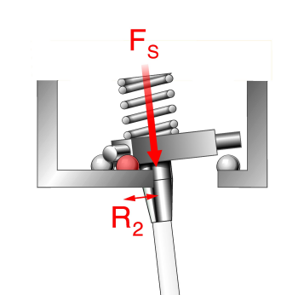
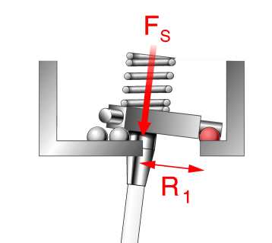
Factors in measurement performance
Pre-travel variation - ‘lobing’
High force direction:
Low force direction:
R₁ > R₂
F_{C1} > F_{C2}
Pivot point
Pivot point
Notes:
The diagram (top right) shows a plan view of the kinematics. The direction of the contact force relative to this triangular arrangement of contacts will determine about which points the mechanism pivots.
In the high force direction, the mechanism must pivot about a single contact. In the low force direction, the mechanism pivots around two contact pairs. The value of R₁ is twice that of R₂, meaning that the spring has greater mechanical advantage in the high force direction and therefore demands a higher contact force to trigger the probe.
A higher contact force results in greater pre-travel in the high force direction. The range of pre-travel as the contact direction varies in the XY plane is known as the XY pre-travel variation (XY PTV).

Slide 14
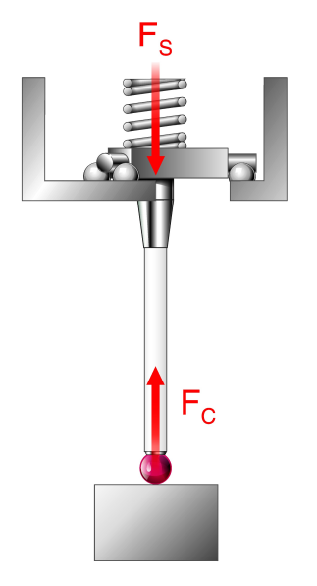
Factors in measurement performance
Pre-travel variation - ‘lobing’
Trigger force in Z direction is higher than in XY plane
  No mechanical advantage over spring
  F_{C} = F_{S}
Kinematic resistive probes exhibit 3D (XYZ) pre-travel variation
  Combination of Z and XY trigger effects
  Low XYZ PTV useful for contoured part inspection
Test data:
ISO 10360-2 3D form
TP20 with 50 mm stylus: 4.0 µm (0.00016 in)
Notes:
Probes are also triggered axially when measuring a flat surface, for instance. In this instance, the contact force must match the spring force to trigger the probe since there is no leverage to exploit. Trigger forces on kinematic resistive probes are much higher in the Z direction than in the XY plane.
Another difference is the greater stiffness in this direction, since the stylus is in compression rather than bending. This means that, despite the higher forces, pre-travel in the Z direction tends to be small.
The 3D or XYZ pre-travel variation is a measure of the sphericity of the probe’s trigger performance, measured by triggering the probe in many directions in both planes. This is an important measure for inspection of contoured parts, where it is not always possible to calibrate the probe is each probing direction.
The high Z trigger force can affect measurement performance on glancing contacts, where the stylus can slide along the surface bending laterally without triggering, A low trigger force and low XYZ PTV characteristic is helpful for inspecting contoured parts.

Slide 15
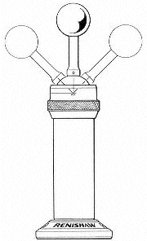
Factors in measurement performance
Probe calibration
Pre-travel can be compensated by probe calibration
A datum feature (of known size and position) is measured to establish the average pre-travel
Key performance factor is repeatability
Limitations
On complex parts, many probing directions may be needed
Low PTV means simple calibration can be used for complex measurements
If PTV is significant compared to allowable measurement error, may need to qualify the probe / stylus in each probing direction
Notes:
Even though pre-travel can be quite large, it’s effects can be eliminated through calibration. By measuring the pre-travel characteristic, compensations can be applied to measured data to get true surface data.
Calibration is needed for each stylus arrangement, since the stiffness and length of the stylus is a critical factor in PTV, as well as the performance and design of the probe itself. Fast and simple calibration routines are therefore desirable, since probe calibration is a regular task on a CMM.
Most calibration routines compensate for an average pre-travel value for the probe / stylus assembly. Pre-travel variation (PTV) will therefore result in small measurement errors either side of the mean pre-travel value.
Once PTV is removed, the key performance factor is repeatability (see next slide).
Calibration is performed on all probes, but there are limitations to trigger probe calibration. If PTV is low, then a few calibration measurements are all that is needed to compensate for the characteristics of each stylus. Probe designs that feature low PTV are therefore useful for complex part inspection.
If a probe has PTV that is significant compared to the allowable measurement error, then it may be necessary to calibrate in each probing directions. For simple routines this is not a problem, but for inspection of complex parts this can itself become complex.

Slide 16
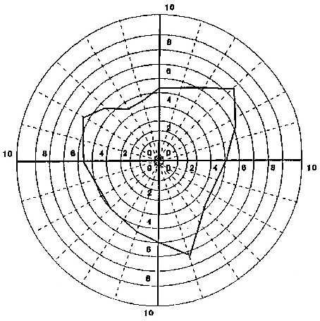
Factors in measurement performance
Typical pre-travel variation
Scale in µm
XY plane
Probe: | TP6
Stylus: | 50 mm
Pre-travel variation: | 3.28 µm
Trigger force: | 15 gram
Repeatability (2 Sigma): | 0.5 µm
Notes:
The diagram shows a pre-travel plot for a typical kinematic resistive probe, showing the triangular ‘lobing’ effect around the XY plane.
A typical calibration cycle will determine the average pre-travel, meaning that any variation in pre-travel will result in measurement errors. In this case, the pre-travel variation is 3.3 microns, whilst the maximum measurement error likely to be encountered through using a single ball radius in all directions will be less than 2 microns.
More sophisticated compensation, where multiple local ball radii are determined and applied depending on the contact vector, is rarely used. Hence probes with low PTV (e.g. strain-gauge sensors) are best suited to complex part inspection.

Slide 17
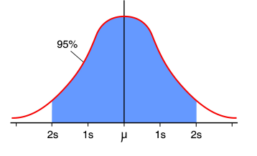
Factors in measurement performance
Repeatability
The ability of a probe to trigger at the same point each time
  A random error with a normal distribution
  For a given probe and probing condition, repeatability is equal to twice the standard deviation (2σ) of the normal distribution
  95% confidence level that all readings taken in this
  mode will repeat within ±2σ from a mean value
Notes:
Once calibration has been performed, repeatability is the critical factor that governs measurement performance. Repeatability is a measure of the range of readings taken by the same probe on the same feature. It arises due to the small variations in mechanical and electrical reseating of the probe mechanism, and is measured in terms of the standard deviation of a Normal distribution.
Renishaw quotes repeatability as 2 sigma values - i.e. 95% of the readings can be expected to fall within the quoted repeatability value of a mean.
Repeatability tends to increase linearly with trigger force and stylus length.
Whilst repeatability is a random phenomenon, hysteresis is a systematic variation that depends on the previous measurement activity. As the probe reseats, its resting position depends on the direction in which it was deflected - the mechanism ‘favours’ the direction in which it was last triggered. This means that another trigger in the same direction will require a little less force than one in a different direction. This effect is superimposed on top of the predictable pre-travle variation that arises due to the design of the mechanism.
Hysteresis is at its highest when a trigger follows a measurement in the opposite direction.
In practice, hysteresis manifests itself as a very small measurement error. The amount of hysteresis for most probes tends to be significantly smaller than the repeatability. The kinematic mechanism ensures a repeatable reseat position with very low hysteresis.

Slide 18
Factors in measurement performance
Hysteresis
Error arising from the direction of the preceding probing move
  Maximum hysteresis occurs when a measurement follows a probing moves in opposite directions to each other in the probe’s XY plane
  Hysteresis error increases linearly with trigger force and stylus length
  Kinematic mechanism minimises hysteresis
Notes:
Once calibration has been performed, repeatability is the critical factor that governs measurement performance. Repeatability is a measure of the range of readings taken by the same probe on the same feature. It arises due to the small variations in mechanical and electrical reseating of the probe mechanism, and is measured in terms of the standard deviation of a Normal distribution.
Renishaw quotes repeatability as 2 sigma values - i.e. 95% of the readings can be expected to fall within the quoted repeatability value of a mean.
Repeatability tends to increase linearly with trigger force and stylus length.
Whilst repeatability is a random phenomenon, hysteresis is a systematic variation that depends on the previous measurement activity. As the probe reseats, its resting position depends on the direction in which it was deflected - the mechanism ‘favours’ the direction in which it was last triggered. This means that another trigger in the same direction will require a little less force than one in a different direction. This effect is superimposed on top of the predictable pre-travle variation that arises due to the design of the mechanism.
Hysteresis is at its highest when a trigger follows a measurement in the opposite direction.
In practice, hysteresis manifests itself as a very small measurement error. The amount of hysteresis for most probes tends to be significantly smaller than the repeatability. The kinematic mechanism ensures a repeatable reseat position with very low hysteresis.

Slide 19
Factors in measurement performance
Ranked in terms of importance
Repeatability
  Key requirement of any trigger probe
  Fundamental limit on system measurement performance
  Hysteresis contributes to measurement repeatability
Pre-travel variation
  Can be calibrated, provided all probing directions are known
  Measurement accuracy will be reduced if probe used in un-qualified direction and PTV is high
  Increases rapidly with stylus length
Hysteresis
  Small error factor for probes with kinematic mechanisms
Notes:
Two factors are vital when selecting in trigger probe:
Repeatability is the ultimate limit for measurement performance.
Pre-travel variation can be compensated, but low PTV is good for measurement of complex parts. PTV increases exponentially with stylus length, so good performance with long styli demands a probe with consistent pre-travel.
Hysteresis manifests itself as a small measurement error and is generally a far smaller value than the other factors. Kinematic stylus seats ensure low hysteresis.

Slide 20
Kinematic resistive probe technology
Simple electro-mechanical switching
Resistive probes use the probe kinematics as an electrical trigger circuit
Pre-travel variation is significant due to the arrangement of the kinematics
Notes:
The kinematic resistive probe mechanism has already been examined in some detail. It is a simple and robust mechanism, that uses electro-mechanical contacts to affect switching.
A consequence of the triangular arrangement of contacts is significant pre-travel variation.
Although trigger forces can be low, these tend to be higher than for strain and shock sensing probes.
These two factors - PTV and higher contact forces - result in limited performance with long styli.

Slide 21
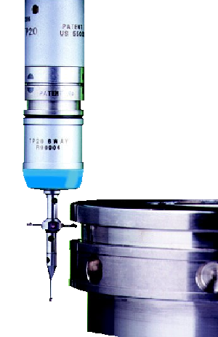
Kinematic resistive probe characteristics
Extremely robust
Compact
  Good part access
  Suitable for long extensions
Good repeatability
  Excellent performance with shorter styli
  Low contact and overtravel forces minimise stylus bending and part deflection
Universal fitment
  Simple interfacing
Cost-effective
Finite operating life
  Electro-mechanical switching
Notes:
Qualities of kinematic resistive probes:
Robust- the kinematic mechanism is simple and rugged, able to cope with shock and vibration.
Compact - small and lightweight probes can be mounted on articulating heads for flexible reorientation, and on long extensions (up to 750 mm), enabling access to deep features.
Repeatability - good mechanical and electrical repeatability is achieved, although repeatability spans are related to the square of stylus length. This means that performance on the smaller trigger probes is compromised with longer styli. However, excellent part access can still be achieved through mounting on extension bars, thus limiting the need for long styli.
Universal fitment - a well established technology, with simple mechanical and electrical installation. Power and signals are carried on just two wires.
Cost-effective - resistive probes feature the simplest technology and are therefore affordable, with low running and replacement costs.
Operating life - the electro-mechanical switch does suffer from wear over time, thus limiting the life of this type of probe. Kinematic resistive probes are therefore not well suited to very high intensity probing applications like ‘peck’ or ‘stitch’ digitising. Such applications are better served by scanning probes or strain gauge touch-trigger sensors.

Slide 22
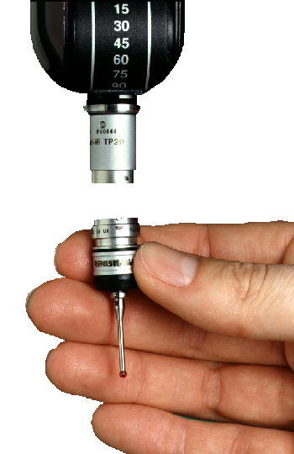
TP20 stylus changing probe
Concept
Direct replacement for TP2
  Ultra-compact probe at just Ø13.2 mm
TP20 features fast and highly repeatable stylus changing
  Manual or automatic
  Enhanced functionality through extended force and extension modules
Notes:
The new industry standard
The TP20 directly replaces the TP2, the previous industry standard touch-trigger probe. The TP20 is fit, form and function compatible, making upgrades simple.
Comparison with TP2:
Same length (37 mm) and diameter (13.2 mm)
TP20 has a wider trigger force range (0.055 N to 0.35 N) to allow for longer styli and probing of soft materials
Same stylus attachment (M2)
Same probe mount (M8)
The principal advantage of TP20 is repeatable stylus changing, which broadens the range of measurement applications that can be supported by such a compact probe.

Slide 23
TP20 stylus changing probe
Benefits
Reduced cycle times achieved by fast stylus changing without re-qualification
Optimised probe and stylus performance with seven specialised probe modules
Easily retrofitted to all Renishaw standard probe heads (M8 or autojoint coupling)
Compatible with existing touch-trigger probe interfaces
Metrology performance equivalent to industry proven TP2 system but with greater flexibility of operation
Notes:
Stylus changing benefits
On complex parts, different styli are often needed to inspect specific features. Stylus changing using magnetic modules can be done in seconds, whilst a manual change can take minutes. There is then the further advantage that the new TP20 stylus need not be qualified if it has already been datumed. This greatly reduces measurement cycle times on complex parts.
Stylus modules
7 different modules mean that you can always select the best one for each measurement task, resulting in better measurement accuracy.
Upgrades
If you currently use a TP2, you can use a TP20 immediately. Full compatibility with existing installations means that you can use existing inspection programmes at once.
Flexibility
Stylus changing brings no loss of measurement performance - only increased flexibility. The TP20 can measure deeper features than a TP2, or softer materials, or undercuts that require 6-way capability.

Slide 24
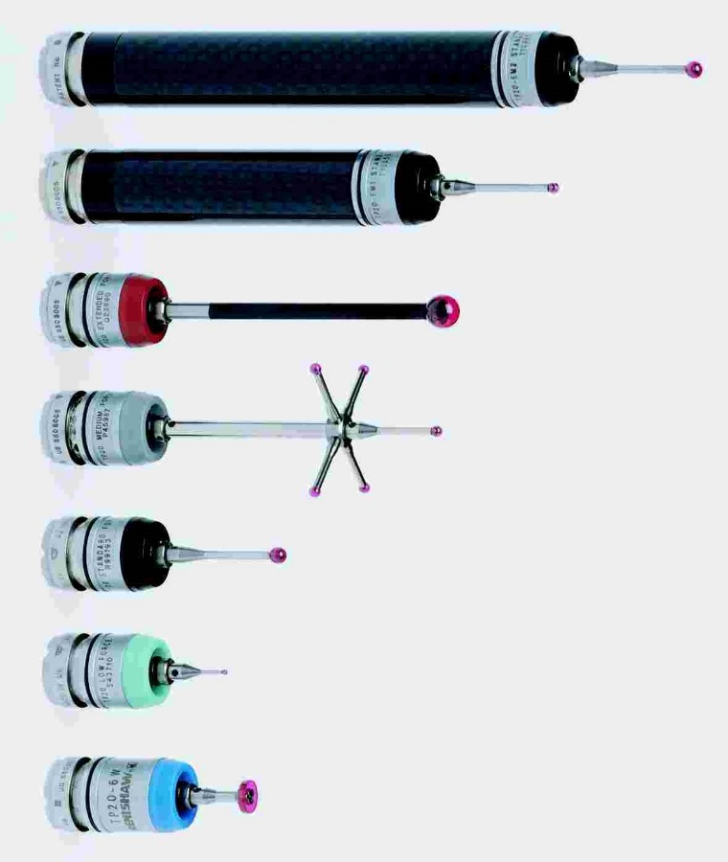
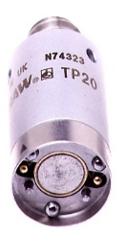
TP20 stylus modules
Optimal measuring performance
Seven specialised probe modules allow optimisation of stylus arrangement for best accuracy and feature access in all user applications
Module attaches to probe body via a quick release, highly repeatable kinematic coupling
Module range covers all forces supported by TP2
6-way module replaces TP2-6W
TP20 probe body
Notes:
Stylus module changing
A range of modules, each with a fixed trigger force, can support a wide range of styli and extensions. A fixed spring force means that, unlike the TP2, you do not need to adjust the force to suit the application (thus voiding your previous stylus qualification results). Your results will be more repeatable, and cycle times will be shorter.
The probe body contains a magnet which retains the stylus module against a set of kinematic contacts. This ensures repeatability, whilst allowing the stylus to detach in the event of a crash.
The low force TP20 stylus module provides a lower trigger force than a TP2 with its spring rate set at the minimum end of its range.
The extended force module provides a higher spring rate than the maximum TP2 value, enabling it to carry heavier styli.
A 6-way TP20 module replaces the discontinued TP2-6W probe, and is suited to measurement of grooves and undercuts.

Slide 25
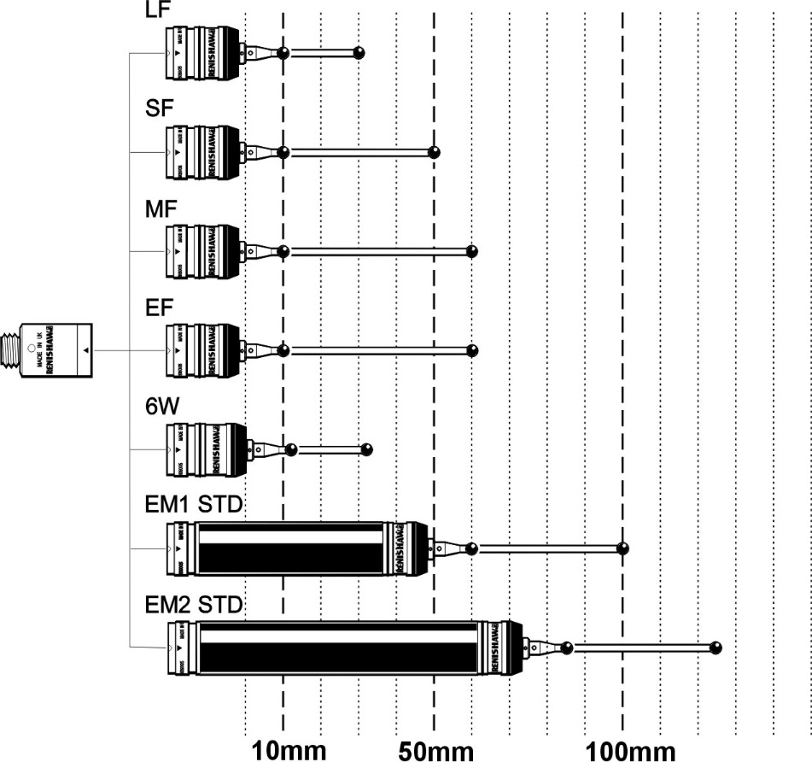

Comparative module and stylus lengths
Soft materials
General use
Longer or heavier styli
Grooves and undercuts
Reach up to 125 mm (5 in)
Notes:
Stylus modules
The range of modules also allows a greater reach into deep features - up to 125 mm with the EM2 standard force module.
The extension modules allow the probe sensor to be positioned closer to the workpiece, improving the measurement performance compared to a conventional probe with a longer stylus.

Slide 26
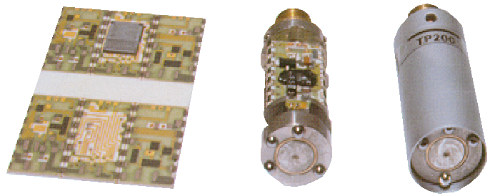
Strain-gauge probe technology
Solid state switching
  Silicon strain gauges measure contact forces transmitted through the stylus
  Trigger signal generated once a threshold force is reached
  Consistent, low trigger force in all directions
  Kinematics retain the stylus / not used for triggering
Notes:
Strain gauge technology
Strain gauge probes use a different sensing technology to resistive probes, whilst still using the kinematic mechanism to mechanically retain the stylus and to provide overtravel. Inside the probe sensor are micro silicon strain gauges that sense the contact force in three directions. The outputs from these three gauges are combined by electronics in the probe, which look for the total force vector to exceed a threshold value. When this threshold is reached, a trigger signal is generated.
Strain gauge probes trigger at a much lower force than resistive probes, meaning that there is less stylus bending or pre-travel. Because they measure the force vector in all three axes at once and combine the results, strain gauge probes are much better suited than resistive sensors to measuring surfaces at compound angles. Unlike resistive probes, they have a consistent trigger force in all directions (resistive probes tend to have much higher trigger forces in Z than in the XY plane).
The signal processing electronics are contained within the probe body, with a trigger signal generated to latch the machine position. Due to the high sensitivity of the sensor, filtering must be applied to the output to prevent machine vibrations causing the probe to trigger when it is not in contact with the part. This filtering introduces a small, fixed delay in the trigger signal whilst the circuit checks to see if the contact is real rather than a transient shock. This delay, typically a few milliseconds, is highly repeatable, ensuring that measurement repeatability is maintained. It is important that the probing speed is constant since the machine motion during the sensing delay forms part of the probe’s trigger characteristic.

Slide 27
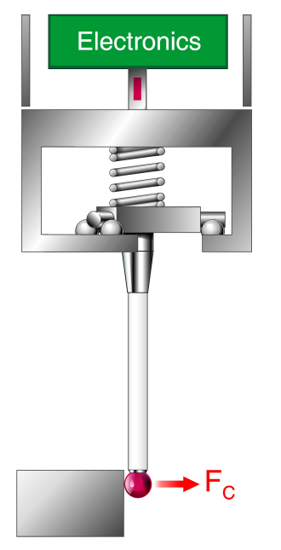
Strain-gauge probe operation
Force sensing
Four strain gauges are mounted on webs
inside the probe body
  X, Y and Z directions, plus one control
  gauge to counter thermal drift
Low contact forces from the stylus tip is transmitted via the kinematics, which remain seated at these low forces
Gauges measure force in each direction and trigger once force threshold is breached (before kinematics are unseated)
Silicon strain gauges mounted on webs
(1 out of 4 shown)
Kinematics remain seated at low F_{C}
Notes:
The diagram shows how the strain gauges are mounted above the kinematics, which are still used to provide overtravel and mechanical repeatability for the stylus.
The strain gauges are aligned to directly sense force in any direction that the stylus makes contact. The gauges are mounted on thin webs of the probe structure to allow them to sense the strains. A fourth gauge is used as a master to eliminate thermal drift from the three measuring gauges.
The strain gauges are very sensitive and can trigger at forces which do not unseat the kinematics. At these forces, the kinematic mechanism is effectively solid.
A key advantage of strain-gauge sensing is the ability to combine the forces in each direction and trigger at a constant force, whichever direction the contact occurs. This largely eliminates the pre-travel variation effects of resistive probes, since the triangular kinematics are not part of the trigger circuit.

Slide 28
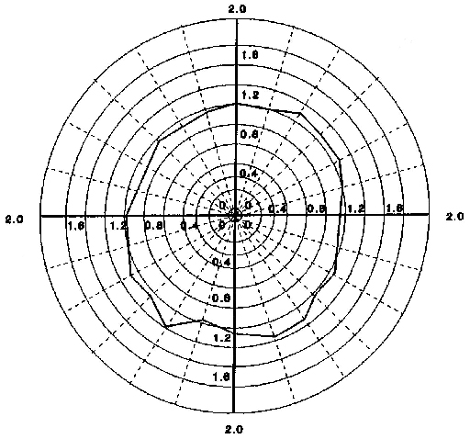
Strain-gauge probe operation
Low lobing measurement
Scale in µm
Trigger force is uniform in all directions
  Very low pre-travel variation
Probe: | TP7M
Stylus: | 50 mm M4
Maximum variation: | 0.34 µm
Sensitivity: | HIGH
Notes:
A key advantage of strain-gauge technology is the low and uniform pre-travel in all probing directions. Strain-gauge sensing effectively eliminates the lobing characteristics of resistive probes, making them ideal for precision measurements on complex parts where measurements must be taken in many different directions.
The plot shows the pre-travel in the XY plane for a typical strain-gauge probe. Note that the scale of this plot is very different to the previous plot for TP6.

Slide 29
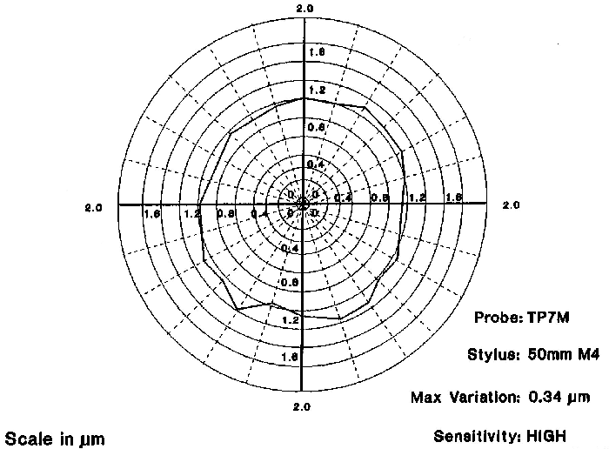
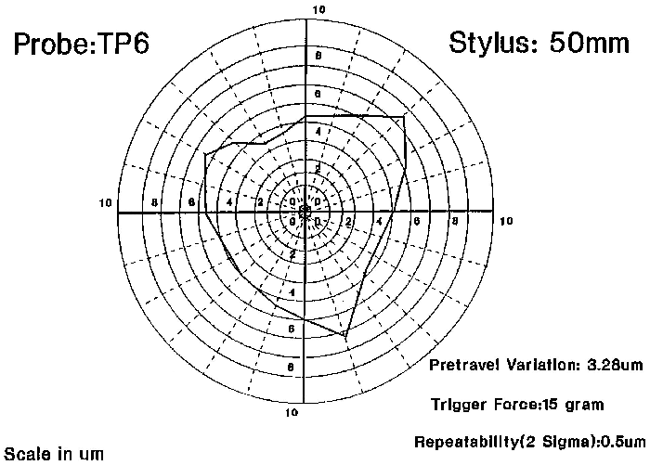
Strain-gauge probe operation
Lobing comparison
Plots at same scale
Strain-gauge
XY PTV = 0.34 μm
Kinematic resistive
XY PTV = 3.28 μm
Notes:
These two plots highlight the difference in performance between a strain-gauge probe and a kinematic resistive probe. The strain-gauge probe delivers a lower and much more consistent pre-travel characteristic.

Slide 30
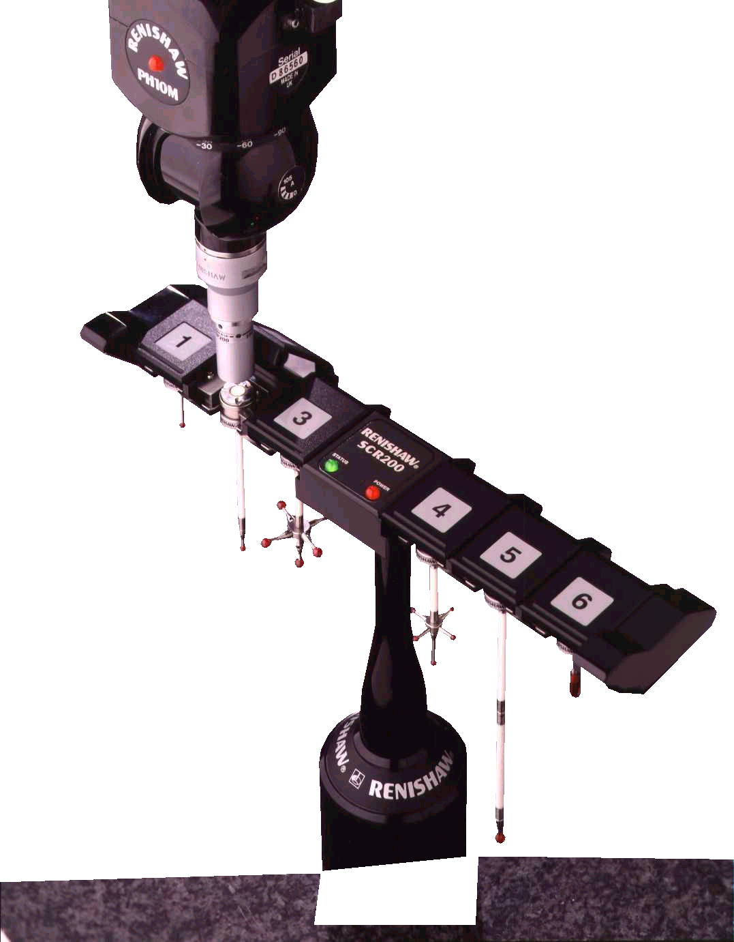
Strain-gauge probe characteristics
High accuracy and repeatability
  Probe accuracy even better than standard kinematic probes
  Minimal lobing (very low pre-travel variation)
Reliable operation
  No reseat failures
  Suitable for intensive "peck" or "stitch” scanning
  Life greater than 10 million triggers
Flexibility
  Long stylus reach
  Suitable for mounting on articulating heads and extension bars
  Stylus changing available on some models
Notes:
Benefits of solid state switching
Strain gauge sensors are more sensitive and trigger at lower forces than resistive probes, making them more repeatable, especially at longer stylus lengths.
Strain gauge probes have the same trigger force in all directions. This force is also low. This means that the level of stylus bending under contact loads is both smaller and more consistent than resistive probes. This manifests itself in smaller pre-travel variation (PTV):
TP7M = 0.25 microns (strain gauge) 50 mm stylus
TP6 = 1 micron (resistive) 22 mm stylus
Resistive probes can suffer from reseat failures, where the resistance around the contact circuit fails to fall below the threshold after a trigger. Reseat failures tend to increase in frequency during the life of the probe. By contrast, strain gauge probes do not use the kinematics for trigger sensing. The trigger circuit does not suffer from electro-mechanical wear.
This reliability makes strain gauge probes suited to high intensity applications like peck scanning. An operating life in excess of 10 million triggers can be expected.
Resistive probes see PTV values that increase with the square of stylus length, meaning that they are best suited to applications with shorter styli. Strain gauge probes can support much longer styli since the PTV value does not increase so rapidly with stylus length.

Slide 31
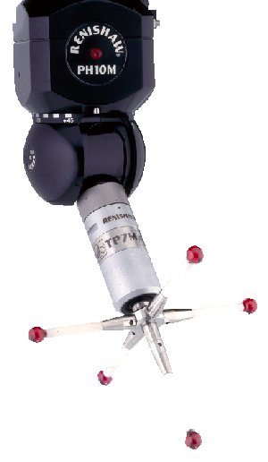
TP7M strain-gauge probe
Concept
  25 mm (1 in) diameter probe
  Autojoint mounted for use with PH10M PLUS
    Multi-wire probe output
Notes:
TP7M
The TP7M was the first strain-gauge probe to be introduced, and is the most repeatable and accurate touch-trigger probe in widespread use. Mounted on an Autojoint, the TP7M can be fitted to PH10M series heads for flexible reorientation, and can be used with PAA series extension bars for greater reach.
Long and star stylus configurations can be used with excellent measurement performance. Graphite fibre styli of up to 180 mm (7.1 in) can be fitted.

Slide 32
TP7M strain-gauge probe
Benefits
  Highest accuracy, even when used with long styli - up to
  180 mm long ("GF" range)
  Compatible with full range of multi-wired probe heads and
  extension bars for flexible part access
  Plus general strain-gauge benefits:
    Non-lobing
    No reseat failures
    Extended operating life
    6-way measuring capability
Notes:
TP7M
The TP7M was the first strain-gauge probe to be introduced, and is the most repeatable and accurate touch-trigger probe in widespread use. Mounted on an Autojoint, the TP7M can be fitted to PH10M series heads for flexible reorientation, and can be used with PAA series extension bars for greater reach.
Long and star stylus configurations can be used with excellent measurement performance. Graphite fibre styli of up to 180 mm (7.1 in) can be fitted.

Slide 33
TP7M performance
Test results from five probes
Notes:
Repeatability
The graphs show test results from 5 TP7M probes, tested on a high accuracy calibration rig. The probes have been triggered up to 20 million times, and still provide measurement repeatability well within the specification. This illustrates the longevity of probes with solid state switching.

Slide 34
TP7M performance
Test results from five probes
Notes:
Pre-travel variation
This graph shows the measured form error in the XY plane (which results from variation in the pre-travel of the probe). Once again, this shows that the trigger characteristic of the probe remains well within specification throughout a very long operating life.

Slide 35
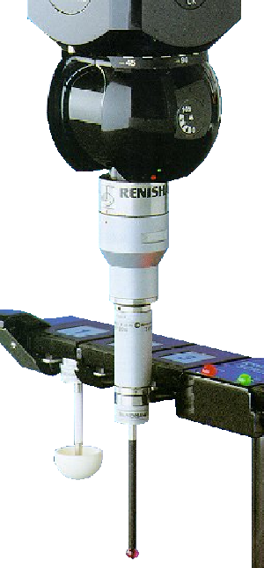
TP200 stylus changing probe
Concept
  TP2-sized probe, with strain gauge accuracy
  Stylus changing for greater flexibility and measurement automation
  2-wire probe output (like TP20)
Benefits
  Long stylus reach - up to 100 mm long ("GF" range)
  Match stylus to the workpiece using high-speed stylus changing
    Improve accuracy for each feature
    No re-qualification
    Manual or automatic changing with SCR200
  Compatible with full range of heads and extension bars
Notes:
TP200
The TP200 is the most widely used strain gauge probe, providing ultra-compact size and stylus changing capability. Whilst the TP200 cannot quite match the measurement performance of the larger TP7M, it’s convenience and size make it ideal for general inspection applications where accuracy and longevity are critical requirements.
Power and signals are carried on two wires, meaning that the TP200 can be fitted to articulating heads that do not have an autojoint.
The TP200 is the same size as the TP20 kinematic resistive probe, and offers similar benefits in terms of part access and flexibility. It exceeds the TP20’s performance in terms of measurement performance with long styli and operating life (> 10 million triggers).

Slide 36
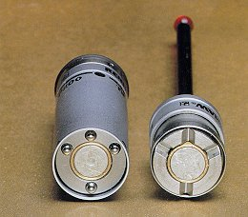
TP200 stylus modules
Optimal sensor performance
6-way operation ±X, ±Y and ±Z
Two types of module:
  SF (standard force)
  LF (low force) provides lower overtravel force option for use with small ball styli and for probing soft materials
Detachable from probe sensor via a highly repeatable magnetic coupling
  Provides overtravel capability
Suitable for both automatic and manual stylus changing
Module life of >10 million triggers
Notes:
TP200 stylus modules
The body of the TP200 contains the strain gauges and signal processing electronics. The magnetically attached stylus module acts simply as an overtravel mechanism with high mechanical repeatability.
Two module types are available with different spring rates. The lower force version is designed to minimise forces on the component after the trigger has been recorded. However, he trigger force is set by the probe electronics, and is the same for both modules.
Strain gauge sensors can detect forces in all six probing axes, including -Z, making the TP200 suitable for measuring grooves and undercuts.

Slide 37
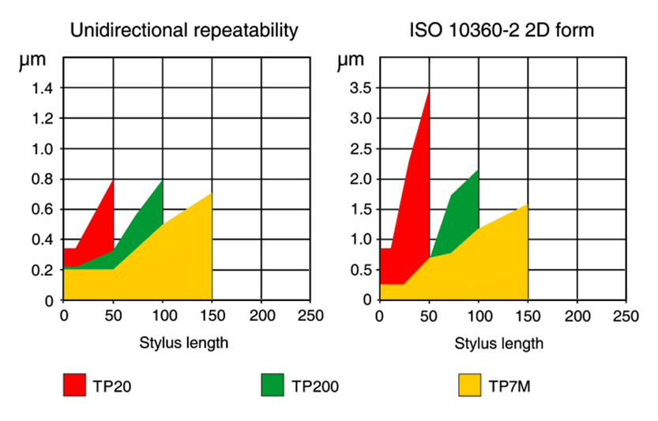
Trigger probe measurement performance comparison
Notes:
These charts show relative performance of four trigger probes, covering the major performance factors of repeatability and PTV.
Repeatability
All probes provide good repeatability with short styli, but strain-gauge and piezo probes perform better at long stylus lengths.
ISO 10360-2 2D form
This chart shows comparative measurement performance in 2D, using the ISO 10360 Part 2 test. The results show the deviation from a circular trigger characteristic (i.e. one in which the same stylus deflection is seen in all directions in the XY plane).
The TP200 and TP7M strain-gauge probes show lower form errors than theTP20 resistive probe. Under the correct conditions, the TP800 can provide exceptionally low PTV at very long stylus lengths.

Slide 38
Renishaw touch-trigger probing technology
Thank you for your attention…

